Slide 1
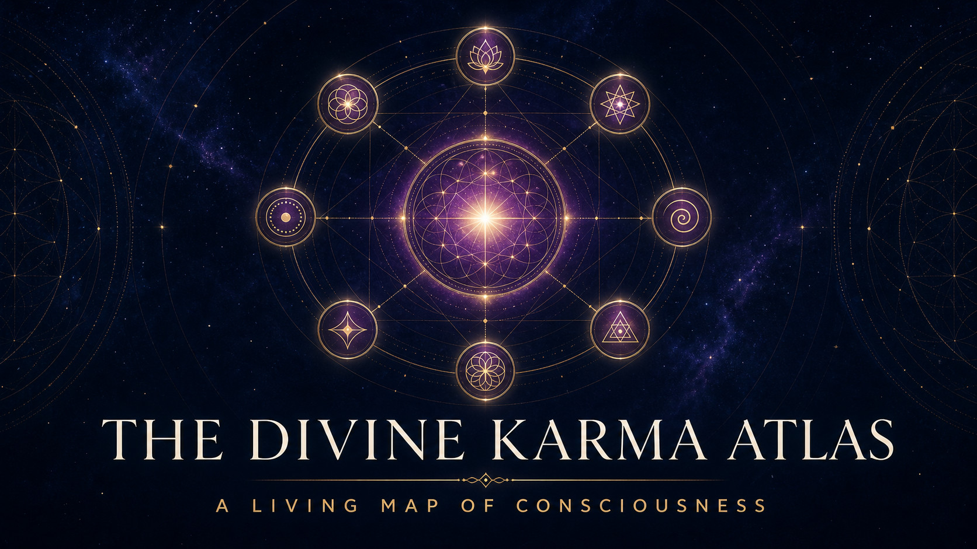
Notes:
[Sources]
- Divine Karma Atlas project; author-approved cover artwork
- Visual asset: atlas-cover.png
- Written teaching: David Ramirez, The Central Thesis (updated Second Movement edition).

Slide 2
HOW TO ENTER THE ATLAS
Look. Reflect. Release.
Each plate is a doorway, not a conclusion.
01
02
03
LOOK
REFLECT
RELEASE
Let the image communicate before reading its explanation.
Use the question to find the concept inside your own experience.
Carry the insight into life, then set the explanation down.
ORIENTATION
2
Notes:
[Sources]
- The Central Thesis, The Illusion of Seeking
- Visual asset: No external visual asset
- Written teaching: David Ramirez, The Central Thesis (updated Second Movement edition).

Slide 3
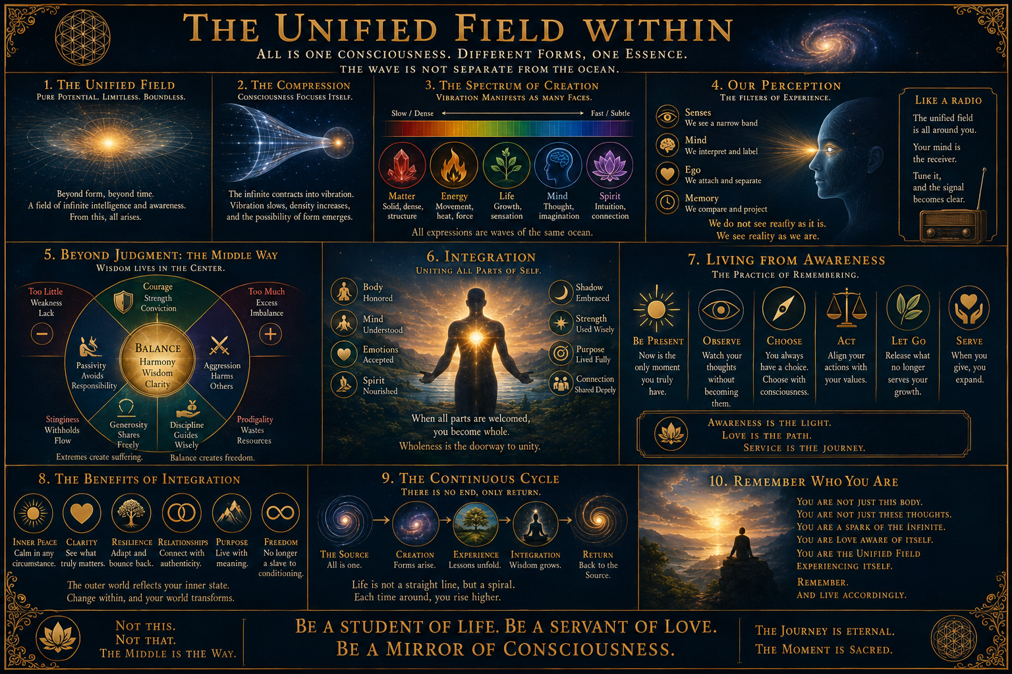
THE CENTRAL THESIS
The Unified Field Within
The whole cosmology lives inside a single life.
THE CENTRAL THESIS
3
Notes:
[Sources]
- The Central Thesis; author-provided illustration
- Visual asset: existing/unified-field-within.png
- Written teaching: David Ramirez, The Central Thesis (updated Second Movement edition).

Slide 4
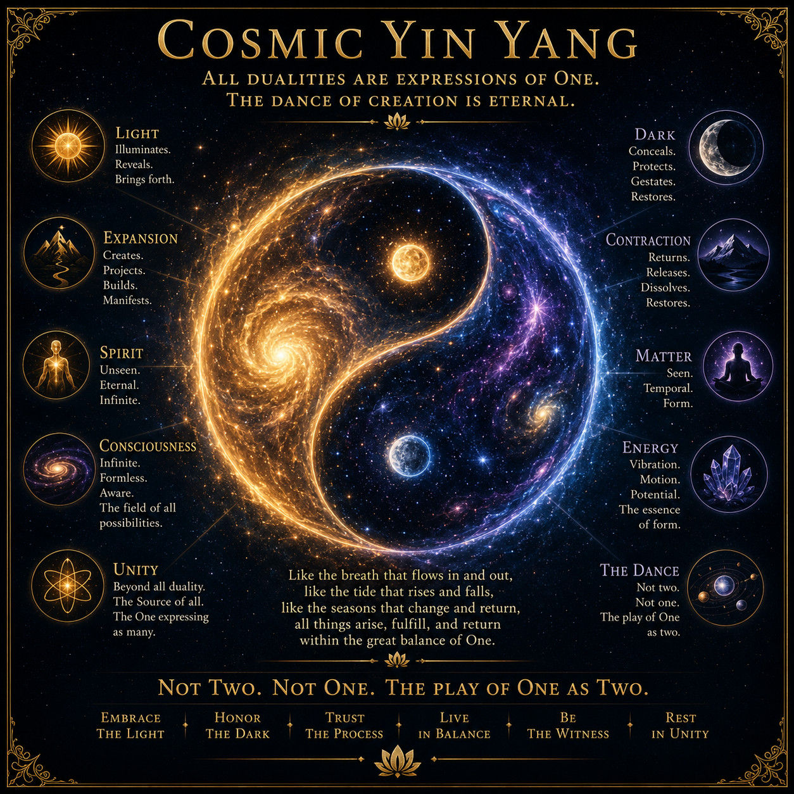
THE CENTRAL THESIS
Cosmic Yin Yang
One reality appears as two so that relationship can exist.
Light and dark, creation and destruction, consciousness and matter are not enemies. They are complementary movements of one whole.
REFLECTION
Which opposite have you mistaken for an enemy?
THE CENTRAL THESIS
4
Notes:
[Sources]
- The Central Thesis; author-provided illustration
- Visual asset: existing/cosmic-yin-yang.png
- Written teaching: David Ramirez, The Central Thesis (updated Second Movement edition).

Slide 5
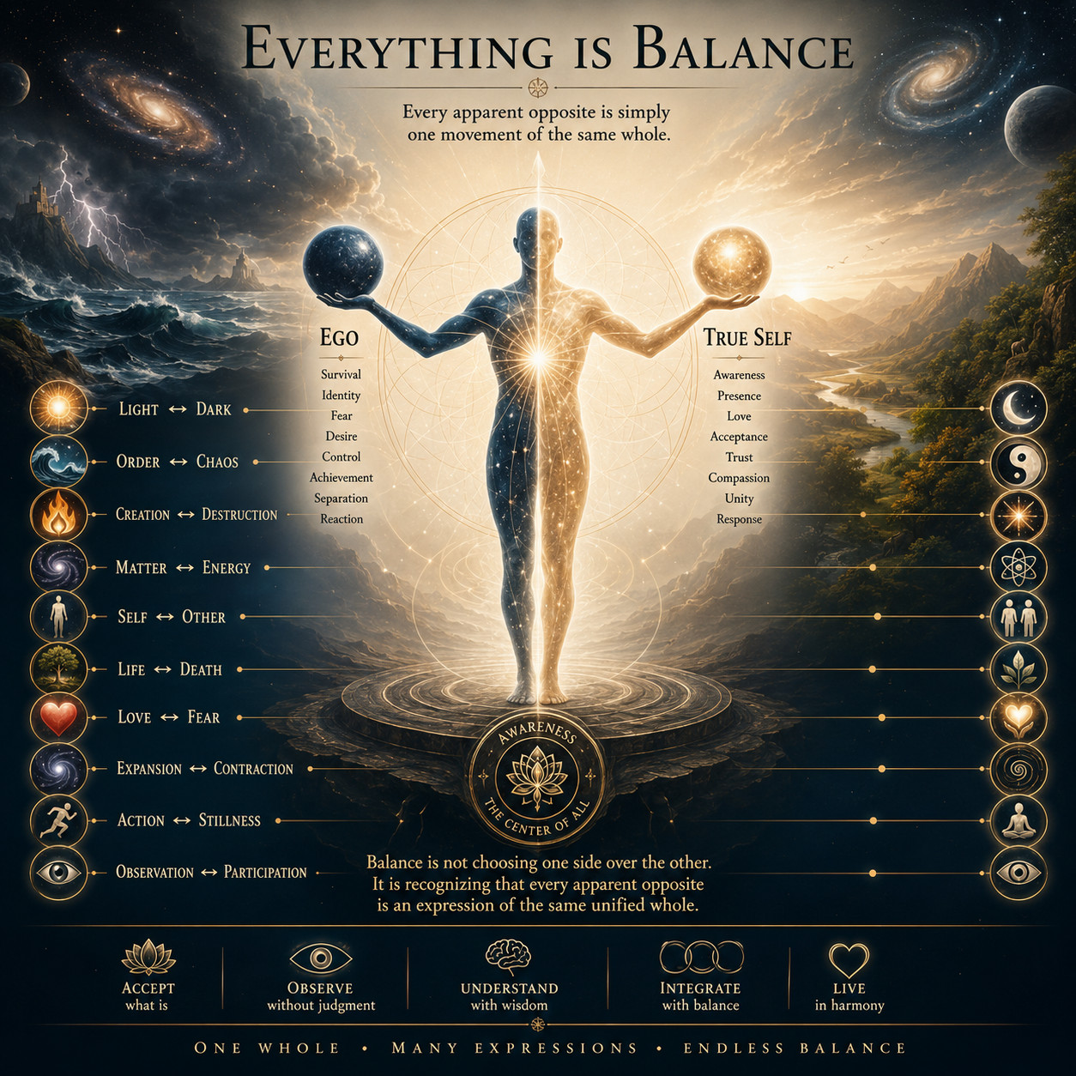
THE CENTRAL THESIS
Everything Is Balance
Balance is not a fixed midpoint. It is living adjustment.
Harmony comes from holding apparent opposites in relationship, not from choosing one side and attempting to erase the other.
REFLECTION
Where is life asking you to adjust rather than conquer?
THE CENTRAL THESIS
5
Notes:
[Sources]
- The Central Thesis; author-provided illustration
- Visual asset: existing/everything-is-balance.png
- Written teaching: David Ramirez, The Central Thesis (updated Second Movement edition).

Slide 6
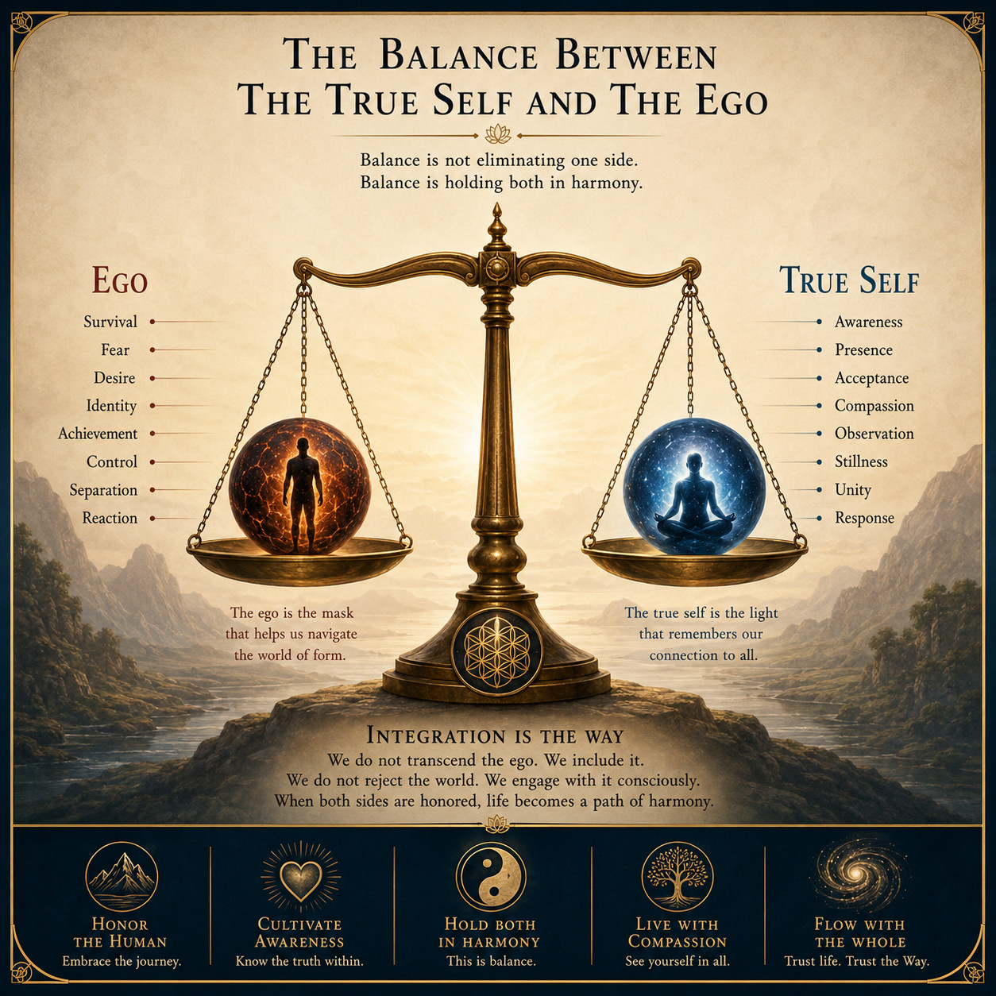
THE CENTRAL THESIS
The Balance Between
The True Self and the Ego
The ego is an instrument, not an enemy.
The Ego Self knows how to survive and operate here. The True Self can witness, choose and restore proportion. Integration is the way.
REFLECTION
What does your survival self need, and what can awareness choose?
THE CENTRAL THESIS
6
Notes:
[Sources]
- The Central Thesis, paragraphs 23 to 28; author-provided illustration
- Visual asset: existing/true-self-and-ego.png
- Written teaching: David Ramirez, The Central Thesis (updated Second Movement edition).

Slide 7
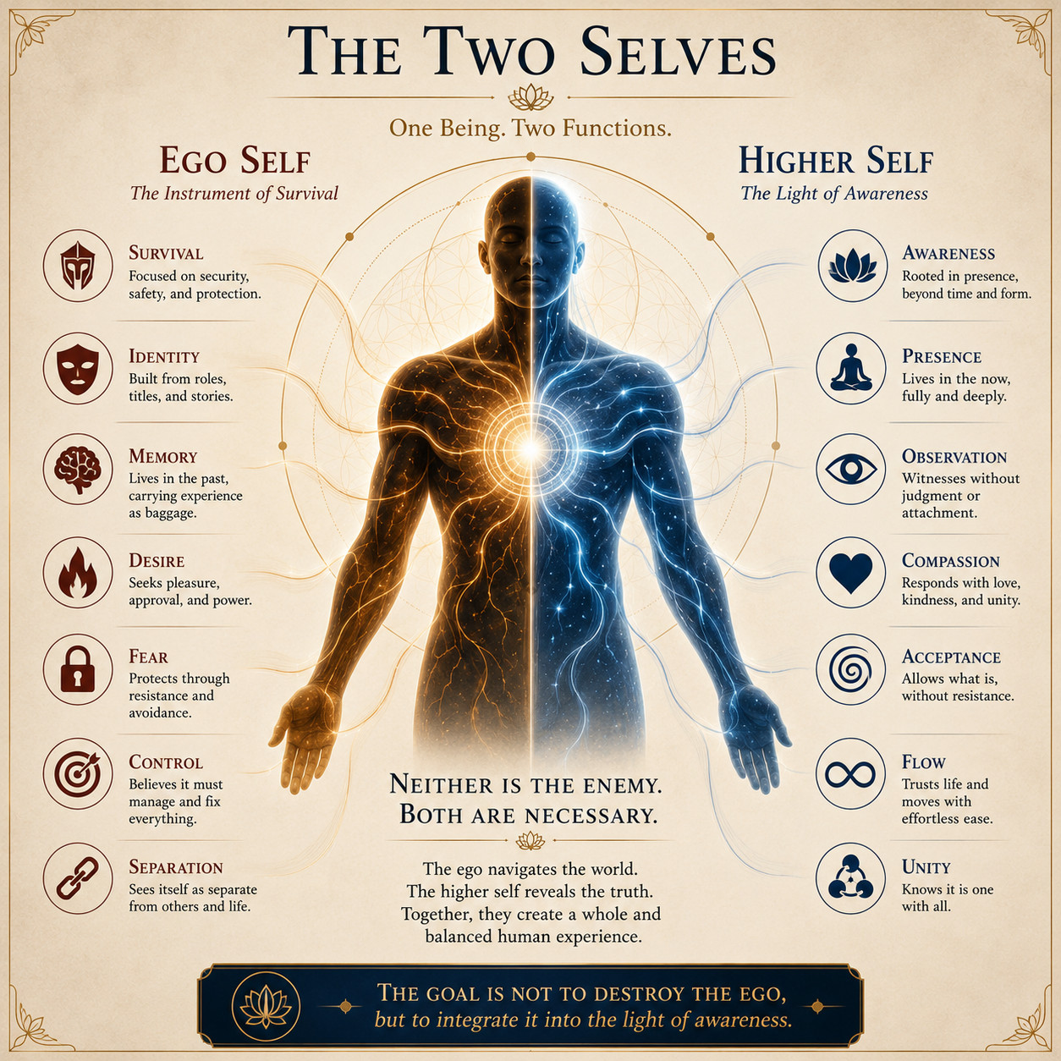
THE CENTRAL THESIS
The Two Selves
One being performs two necessary functions.
Identity, memory and desire help us navigate. Awareness, presence and compassion keep the instrument from becoming the whole self.
REFLECTION
Which function is currently leading your life?
THE CENTRAL THESIS
7
Notes:
[Sources]
- The Central Thesis; author-provided illustration
- Visual asset: existing/two-selves.png
- Written teaching: David Ramirez, The Central Thesis (updated Second Movement edition).

Slide 8
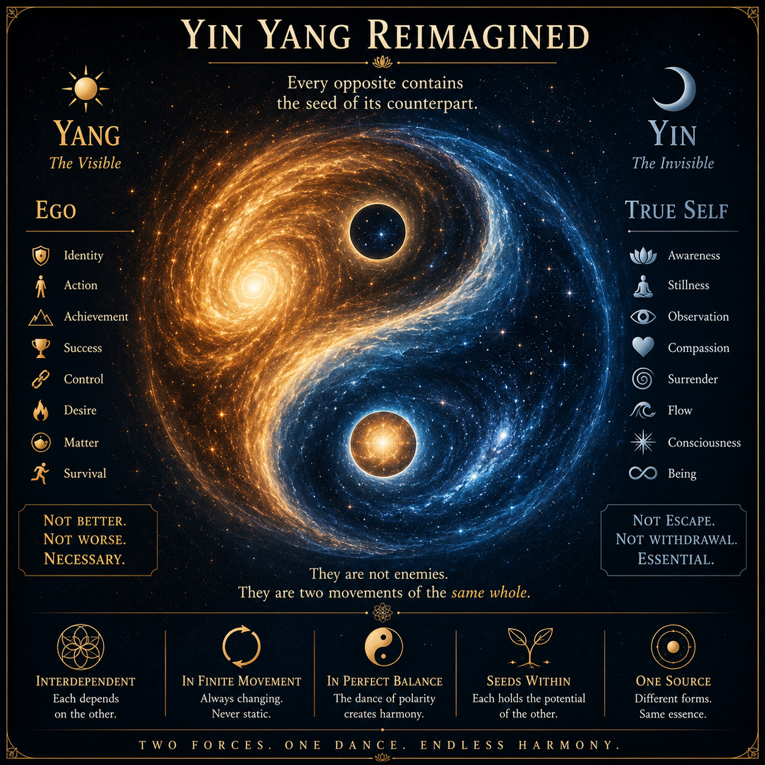
THE CENTRAL THESIS
Yin Yang Reimagined
Every opposite carries the seed of its counterpart.
Action contains stillness. Strength contains vulnerability. The visible world contains the invisible field that gives it form.
REFLECTION
What seed of the opposite is already present?
THE CENTRAL THESIS
8
Notes:
[Sources]
- The Central Thesis; author-provided illustration
- Visual asset: existing/yin-yang-reimagined.png
- Written teaching: David Ramirez, The Central Thesis (updated Second Movement edition).

Slide 9
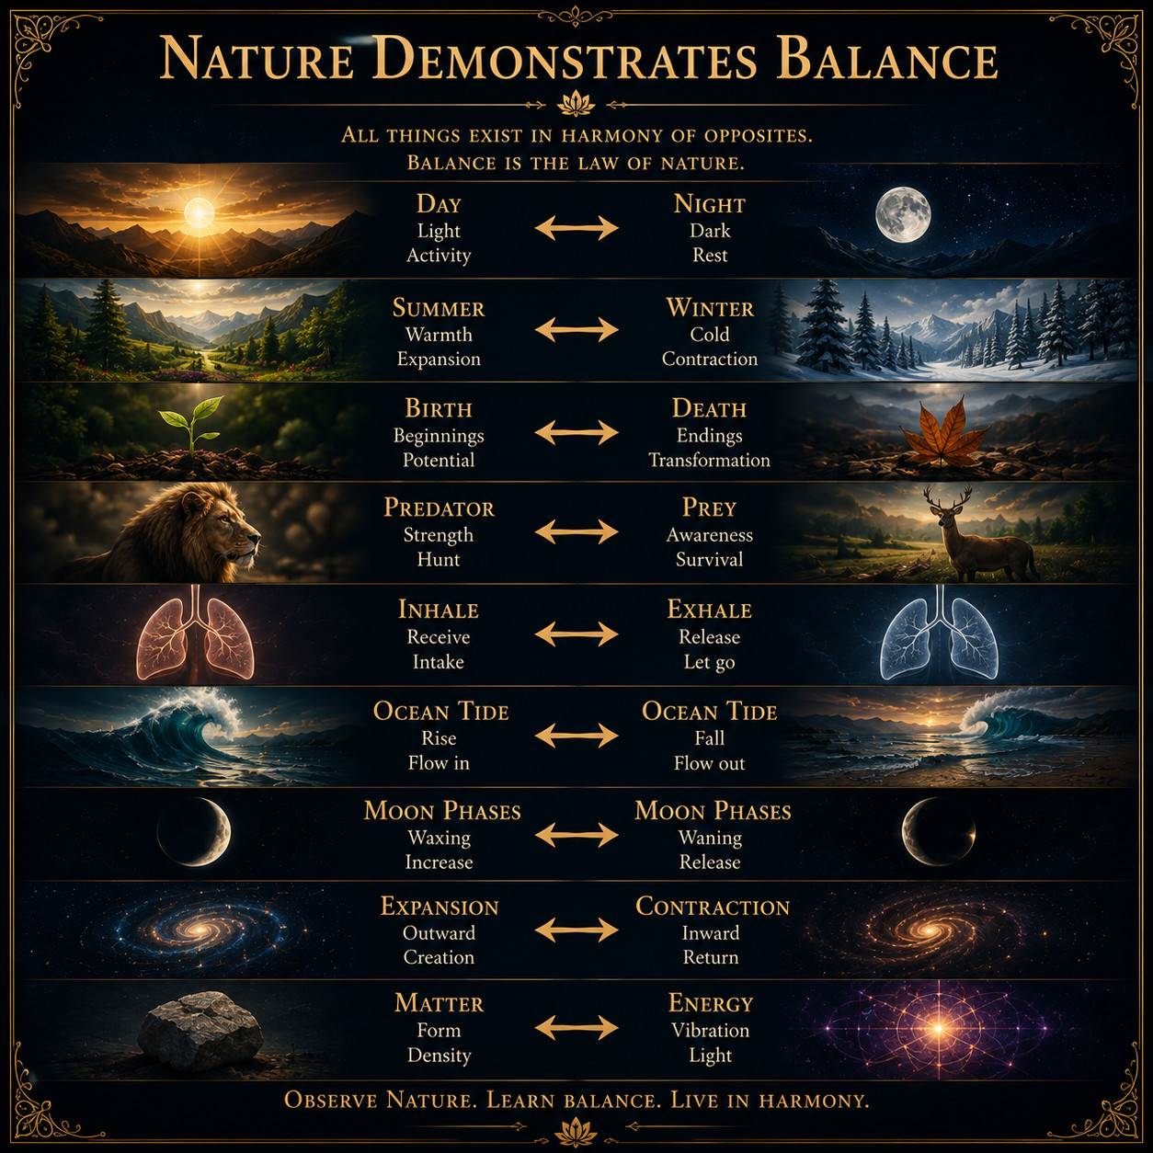
LIVING IN BALANCE
Nature Demonstrates Balance
Nature maintains itself through continual adjustment.
Day and night, inhale and exhale, expansion and contraction: equilibrium is dynamic, responsive and alive.
REFLECTION
What natural rhythm have you been trying to freeze?
LIVING IN BALANCE
9
Notes:
[Sources]
- The Central Thesis, second movement; author-provided illustration
- Visual asset: existing/nature-demonstrates-balance.png
- Written teaching: David Ramirez, The Central Thesis (updated Second Movement edition).

Slide 10
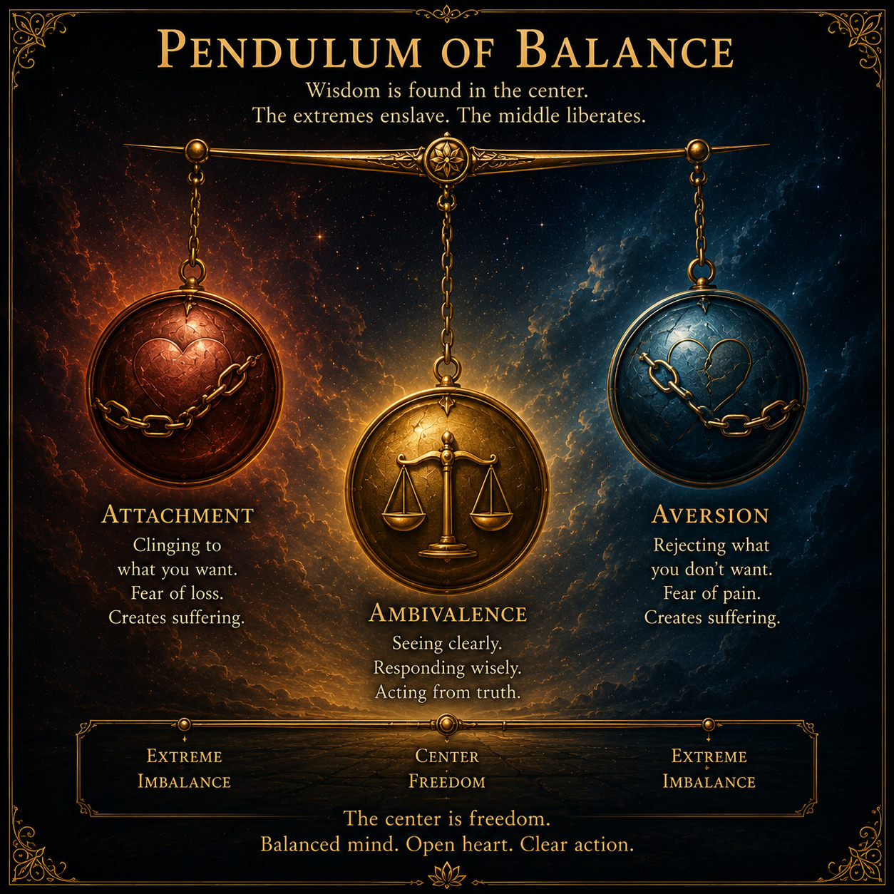
LIVING IN BALANCE
The Pendulum of Balance
Attachment and aversion are opposite pushes on the same swing.
Freedom appears when we stop feeding either extreme and allow accumulated motion to settle toward the center.
REFLECTION
Which pattern changes if you stop adding the next push?
LIVING IN BALANCE
10
Notes:
[Sources]
- The Central Thesis; The Revolution of the Mind; author-provided illustration
- Visual asset: existing/pendulum-of-balance.png
- Written teaching: David Ramirez, The Central Thesis (updated Second Movement edition).

Slide 11
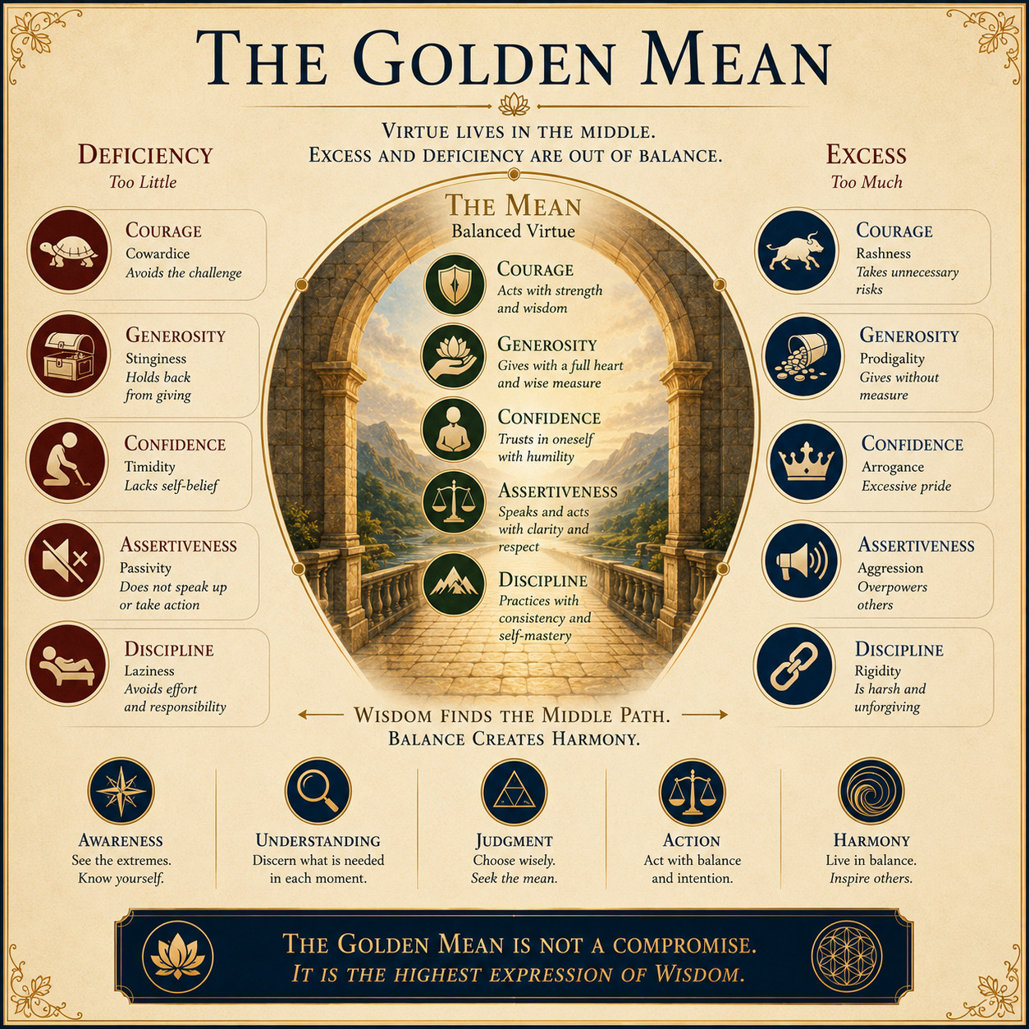
LIVING IN BALANCE
The Golden Mean
Virtue is the intelligent balance between deficiency and excess.
The middle is not compromise. It is the responsive measure that allows courage, generosity, patience and love to remain whole.
REFLECTION
Where has too much become another form of too little?
LIVING IN BALANCE
11
Notes:
[Sources]
- The Central Thesis; author-provided illustration
- Visual asset: existing/golden-mean.png
- Written teaching: David Ramirez, The Central Thesis (updated Second Movement edition).

Slide 12
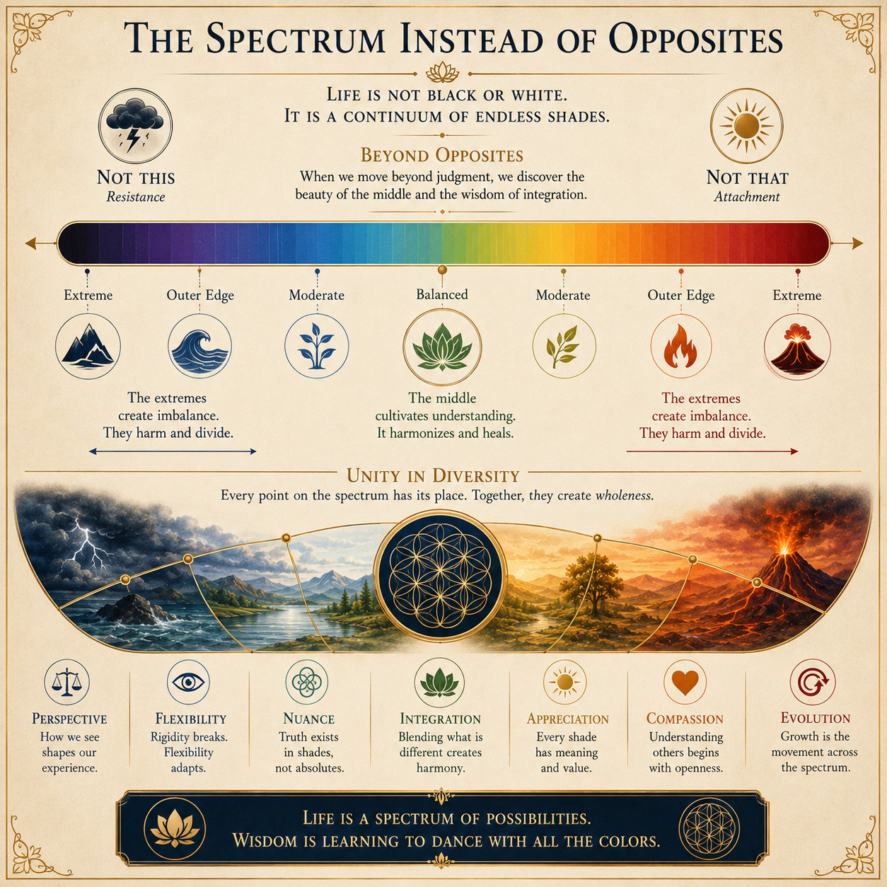
LIVING IN BALANCE
The Spectrum Instead
of Opposites
Life moves across continua rather than living in absolutes.
Cold and heat, order and chaos, self and other are positions within a changing field, not permanent identities.
REFLECTION
What becomes possible when you stop thinking in absolutes?
LIVING IN BALANCE
12
Notes:
[Sources]
- The Central Thesis; author-provided illustration
- Visual asset: existing/spectrum-opposites.png
- Written teaching: David Ramirez, The Central Thesis (updated Second Movement edition).

Slide 13
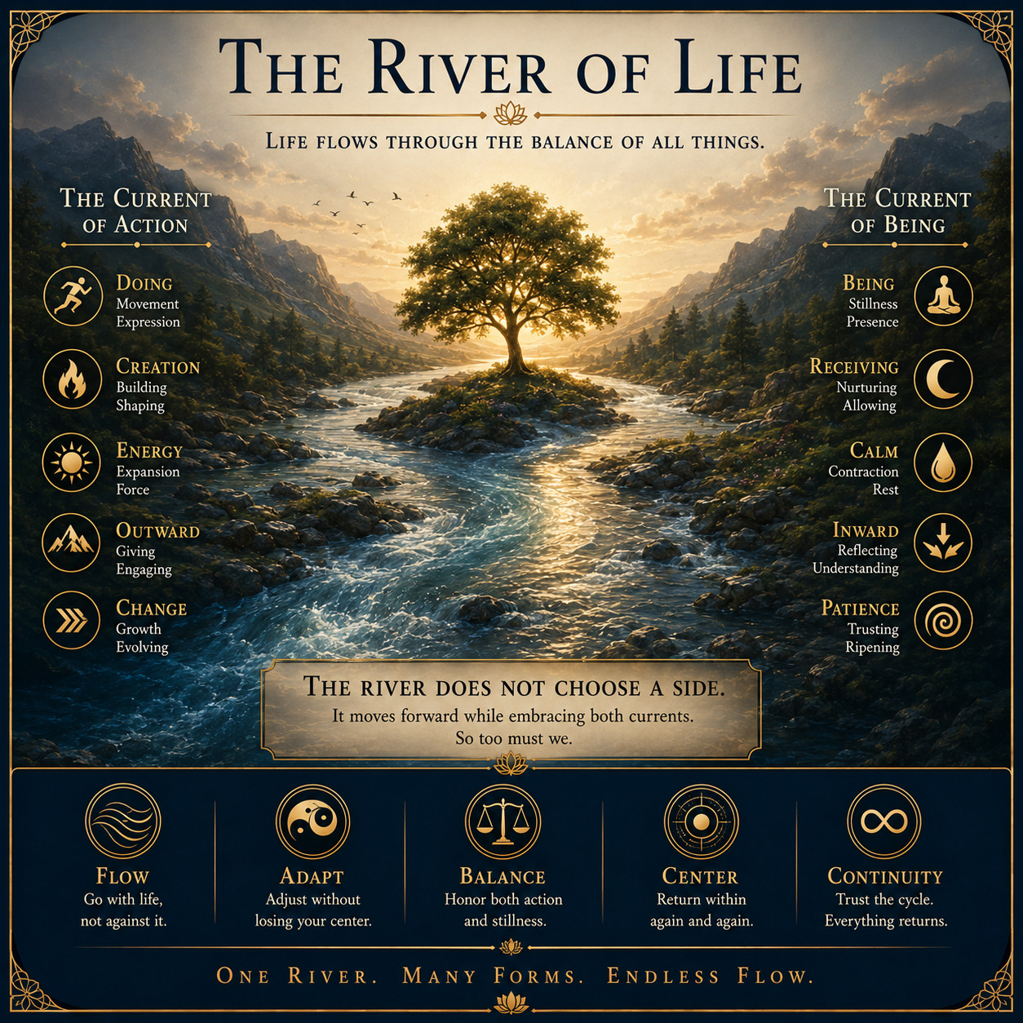
LIVING IN BALANCE
The River of Life
Resistance creates turbulence; awareness learns the current.
Wu wei is action without forcing: fully participating while no longer demanding that the river obey the ego's preferred route.
REFLECTION
Where are you fighting a current that needs to be read?
LIVING IN BALANCE
13
Notes:
[Sources]
- The Central Thesis, paragraph 28; author-provided illustration
- Visual asset: existing/river-of-life.png
- Written teaching: David Ramirez, The Central Thesis (updated Second Movement edition).

Slide 14
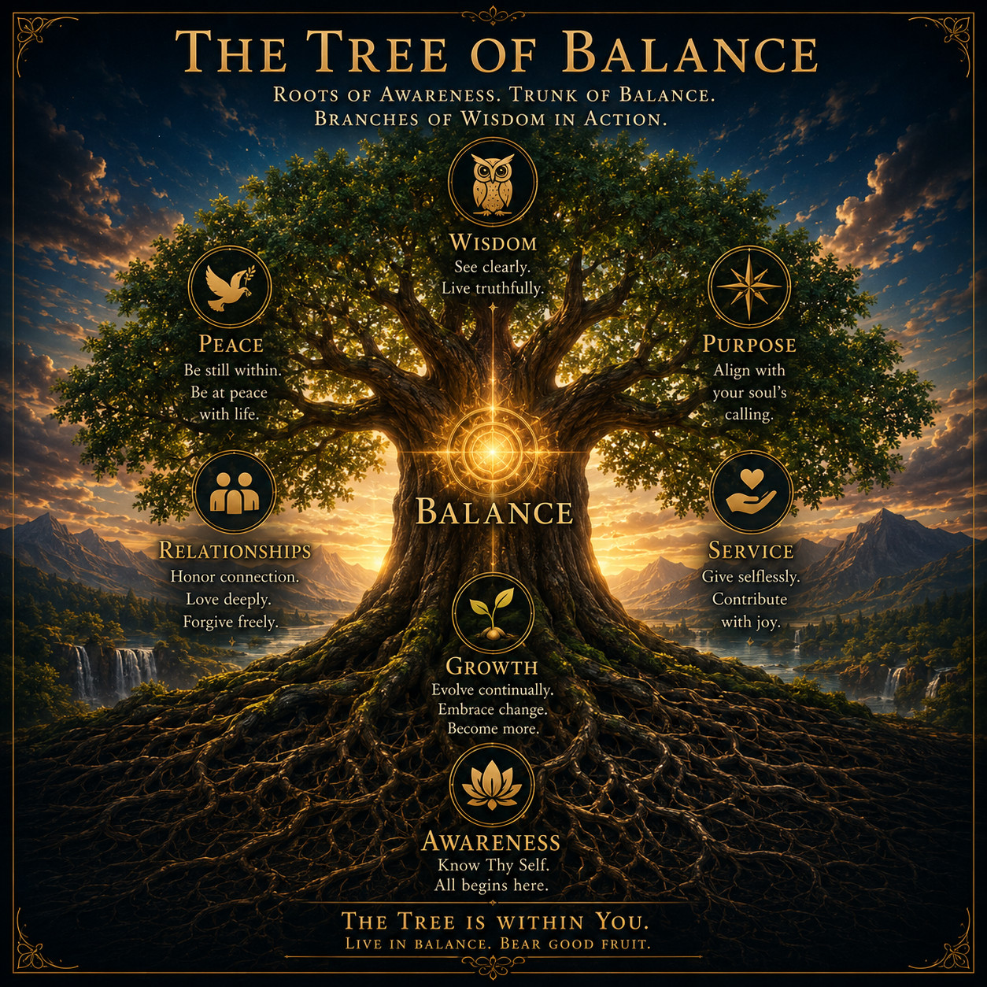
LIVING IN BALANCE
The Tree of Balance
Awareness is the root system of a balanced life.
Peace, purpose, wisdom, service and relationship grow more steadily when they emerge from an inner center.
REFLECTION
Which root needs attention before another branch can grow?
LIVING IN BALANCE
14
Notes:
[Sources]
- The Central Thesis; author-provided illustration
- Visual asset: existing/tree-of-balance.png
- Written teaching: David Ramirez, The Central Thesis (updated Second Movement edition).

Slide 15
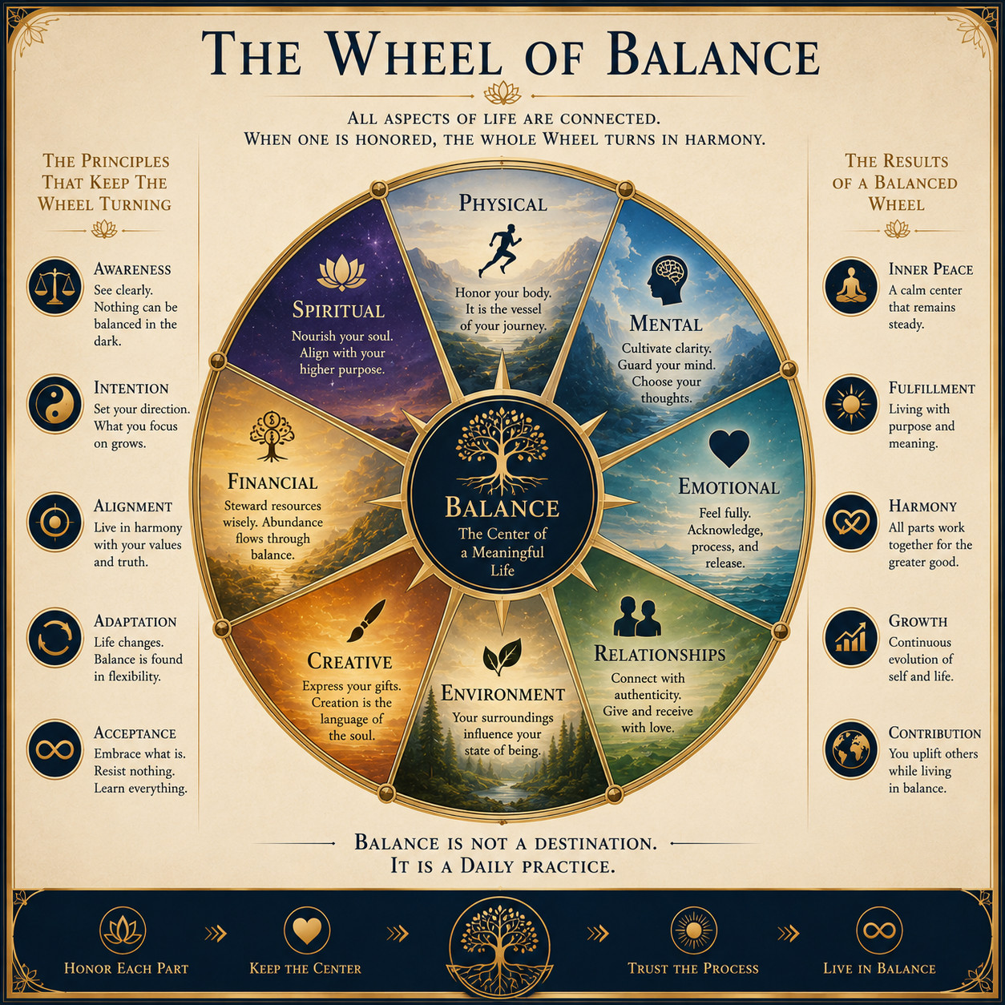
LIVING IN BALANCE
The Wheel of Balance
A life turns smoothly when its domains share one center.
Spirituality is not separate from health, work, play, relationship or rest. Awareness belongs at the hub of all of them.
REFLECTION
Which part of your wheel is carrying too much weight?
LIVING IN BALANCE
15
Notes:
[Sources]
- The Central Thesis; author-provided illustration
- Visual asset: existing/wheel-of-balance.png
- Written teaching: David Ramirez, The Central Thesis (updated Second Movement edition).

Slide 16
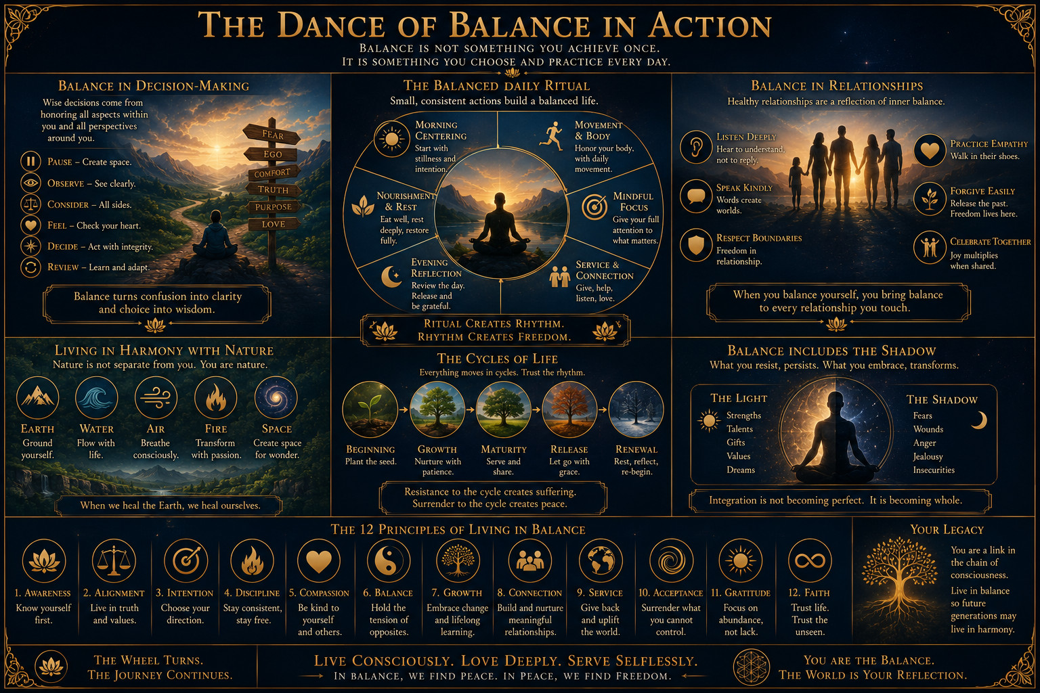
LIVING IN BALANCE
The Dance of Balance in Action
Balance becomes real only through ordinary choices.
LIVING IN BALANCE
16
Notes:
[Sources]
- The Central Thesis; author-provided illustration
- Visual asset: existing/dance-of-balance.png
- Written teaching: David Ramirez, The Central Thesis (updated Second Movement edition).

Slide 17
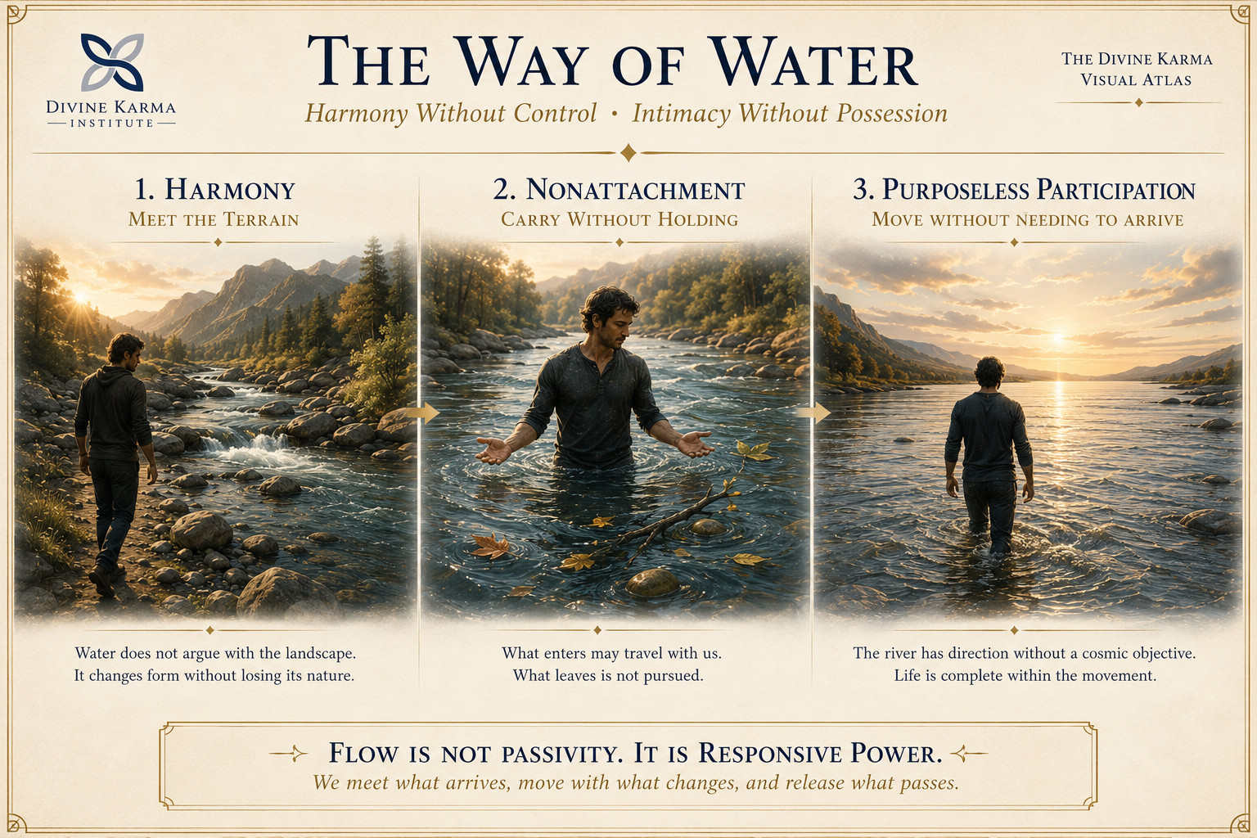
LIVING IN BALANCE
The Way of Water
Harmony without control; intimacy without possession.
LIVING IN BALANCE
17
Notes:
[Sources]
- User-supplied Divine Karma Visual Atlas illustration, August 18, 2026
- Visual asset: /Users/talos/Desktop/Divine Karma Institute/Codex Image Aug 18, 2026, 01_17_14 PM.png
- Written teaching: David Ramirez, The Central Thesis (updated Second Movement edition).

Slide 18
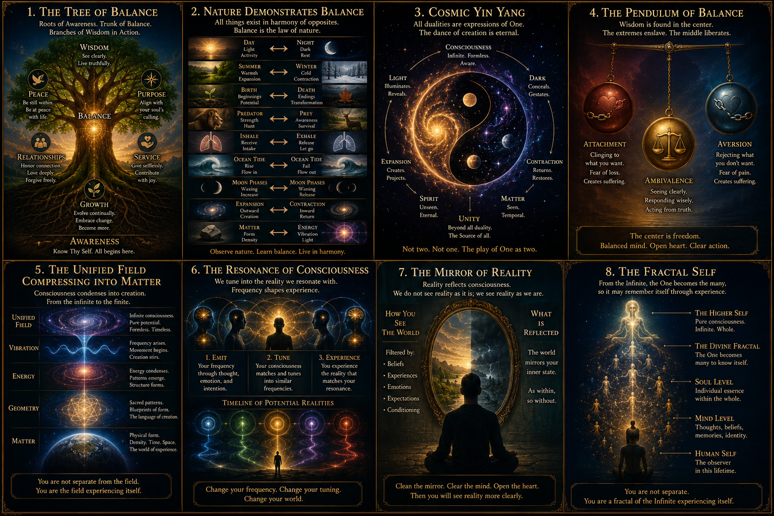
THE CENTRAL THESIS
The Thesis at a Glance
The teaching is one field viewed through many doorways.
THE CENTRAL THESIS
18
Notes:
[Sources]
- The Central Thesis; author-provided illustration
- Visual asset: existing/thesis-at-a-glance.png
- Written teaching: David Ramirez, The Central Thesis (updated Second Movement edition).

Slide 19
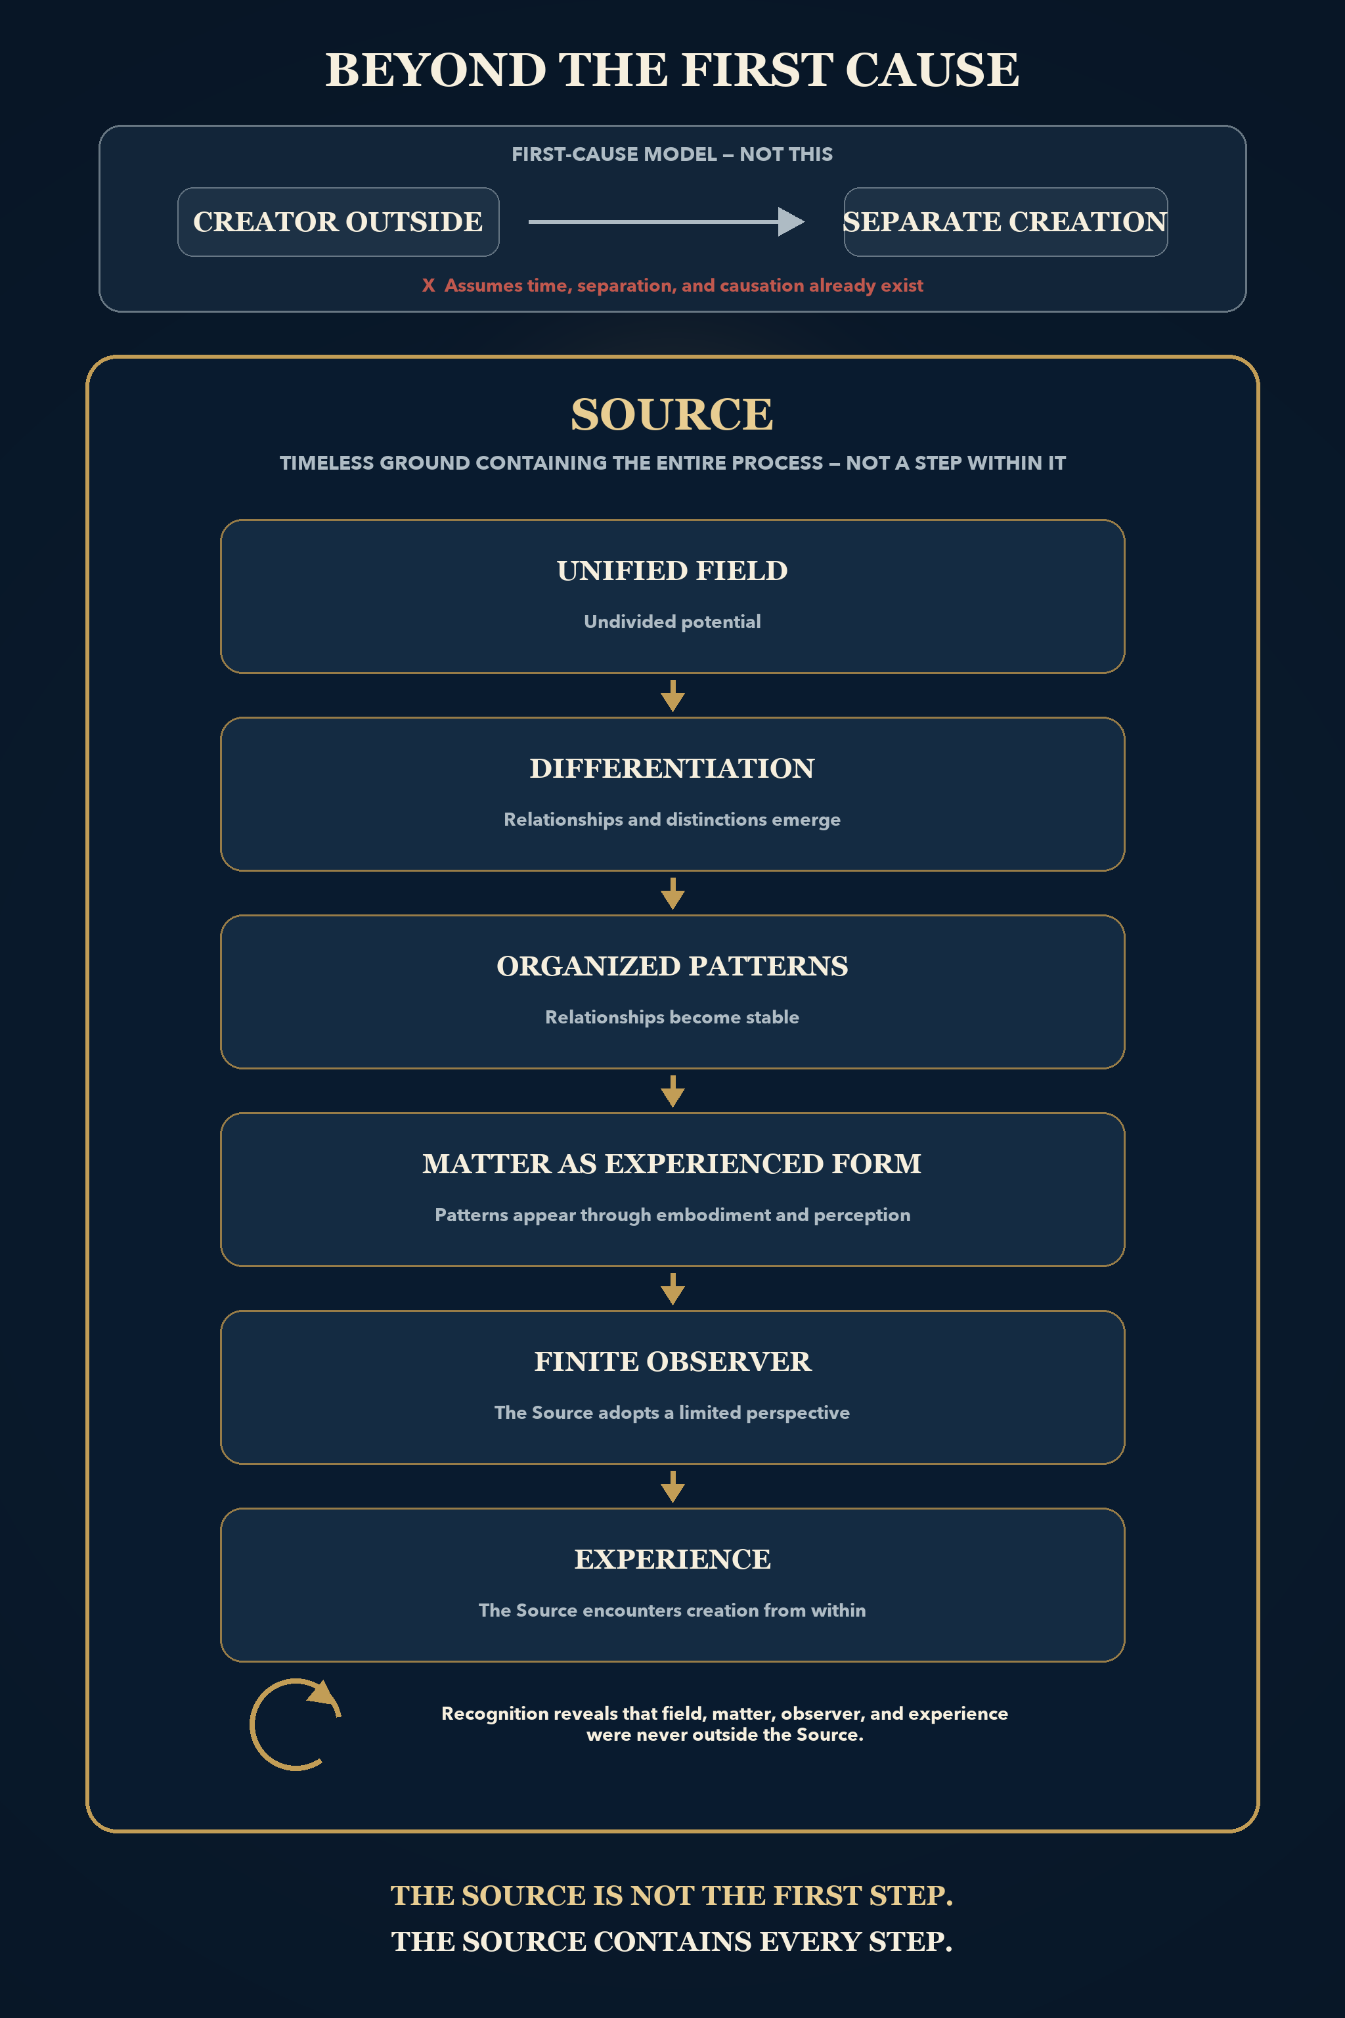
THE FRACTAL SELF
Beyond the First Cause
The ground of possibility beneath every apparent cause.
Before any first cause there is the field in which causes can occur at all.
REFLECTION
What do you treat as the beginning that is itself an effect?
THE FRACTAL SELF
19
Notes:
[Sources]
- The Central Thesis, paragraphs 30 to 31; OpenAI ImageGen illustration
- Visual asset: second-movement/avoidance-to-healing.png
- Written teaching: David Ramirez, The Central Thesis (updated Second Movement edition).

Slide 20
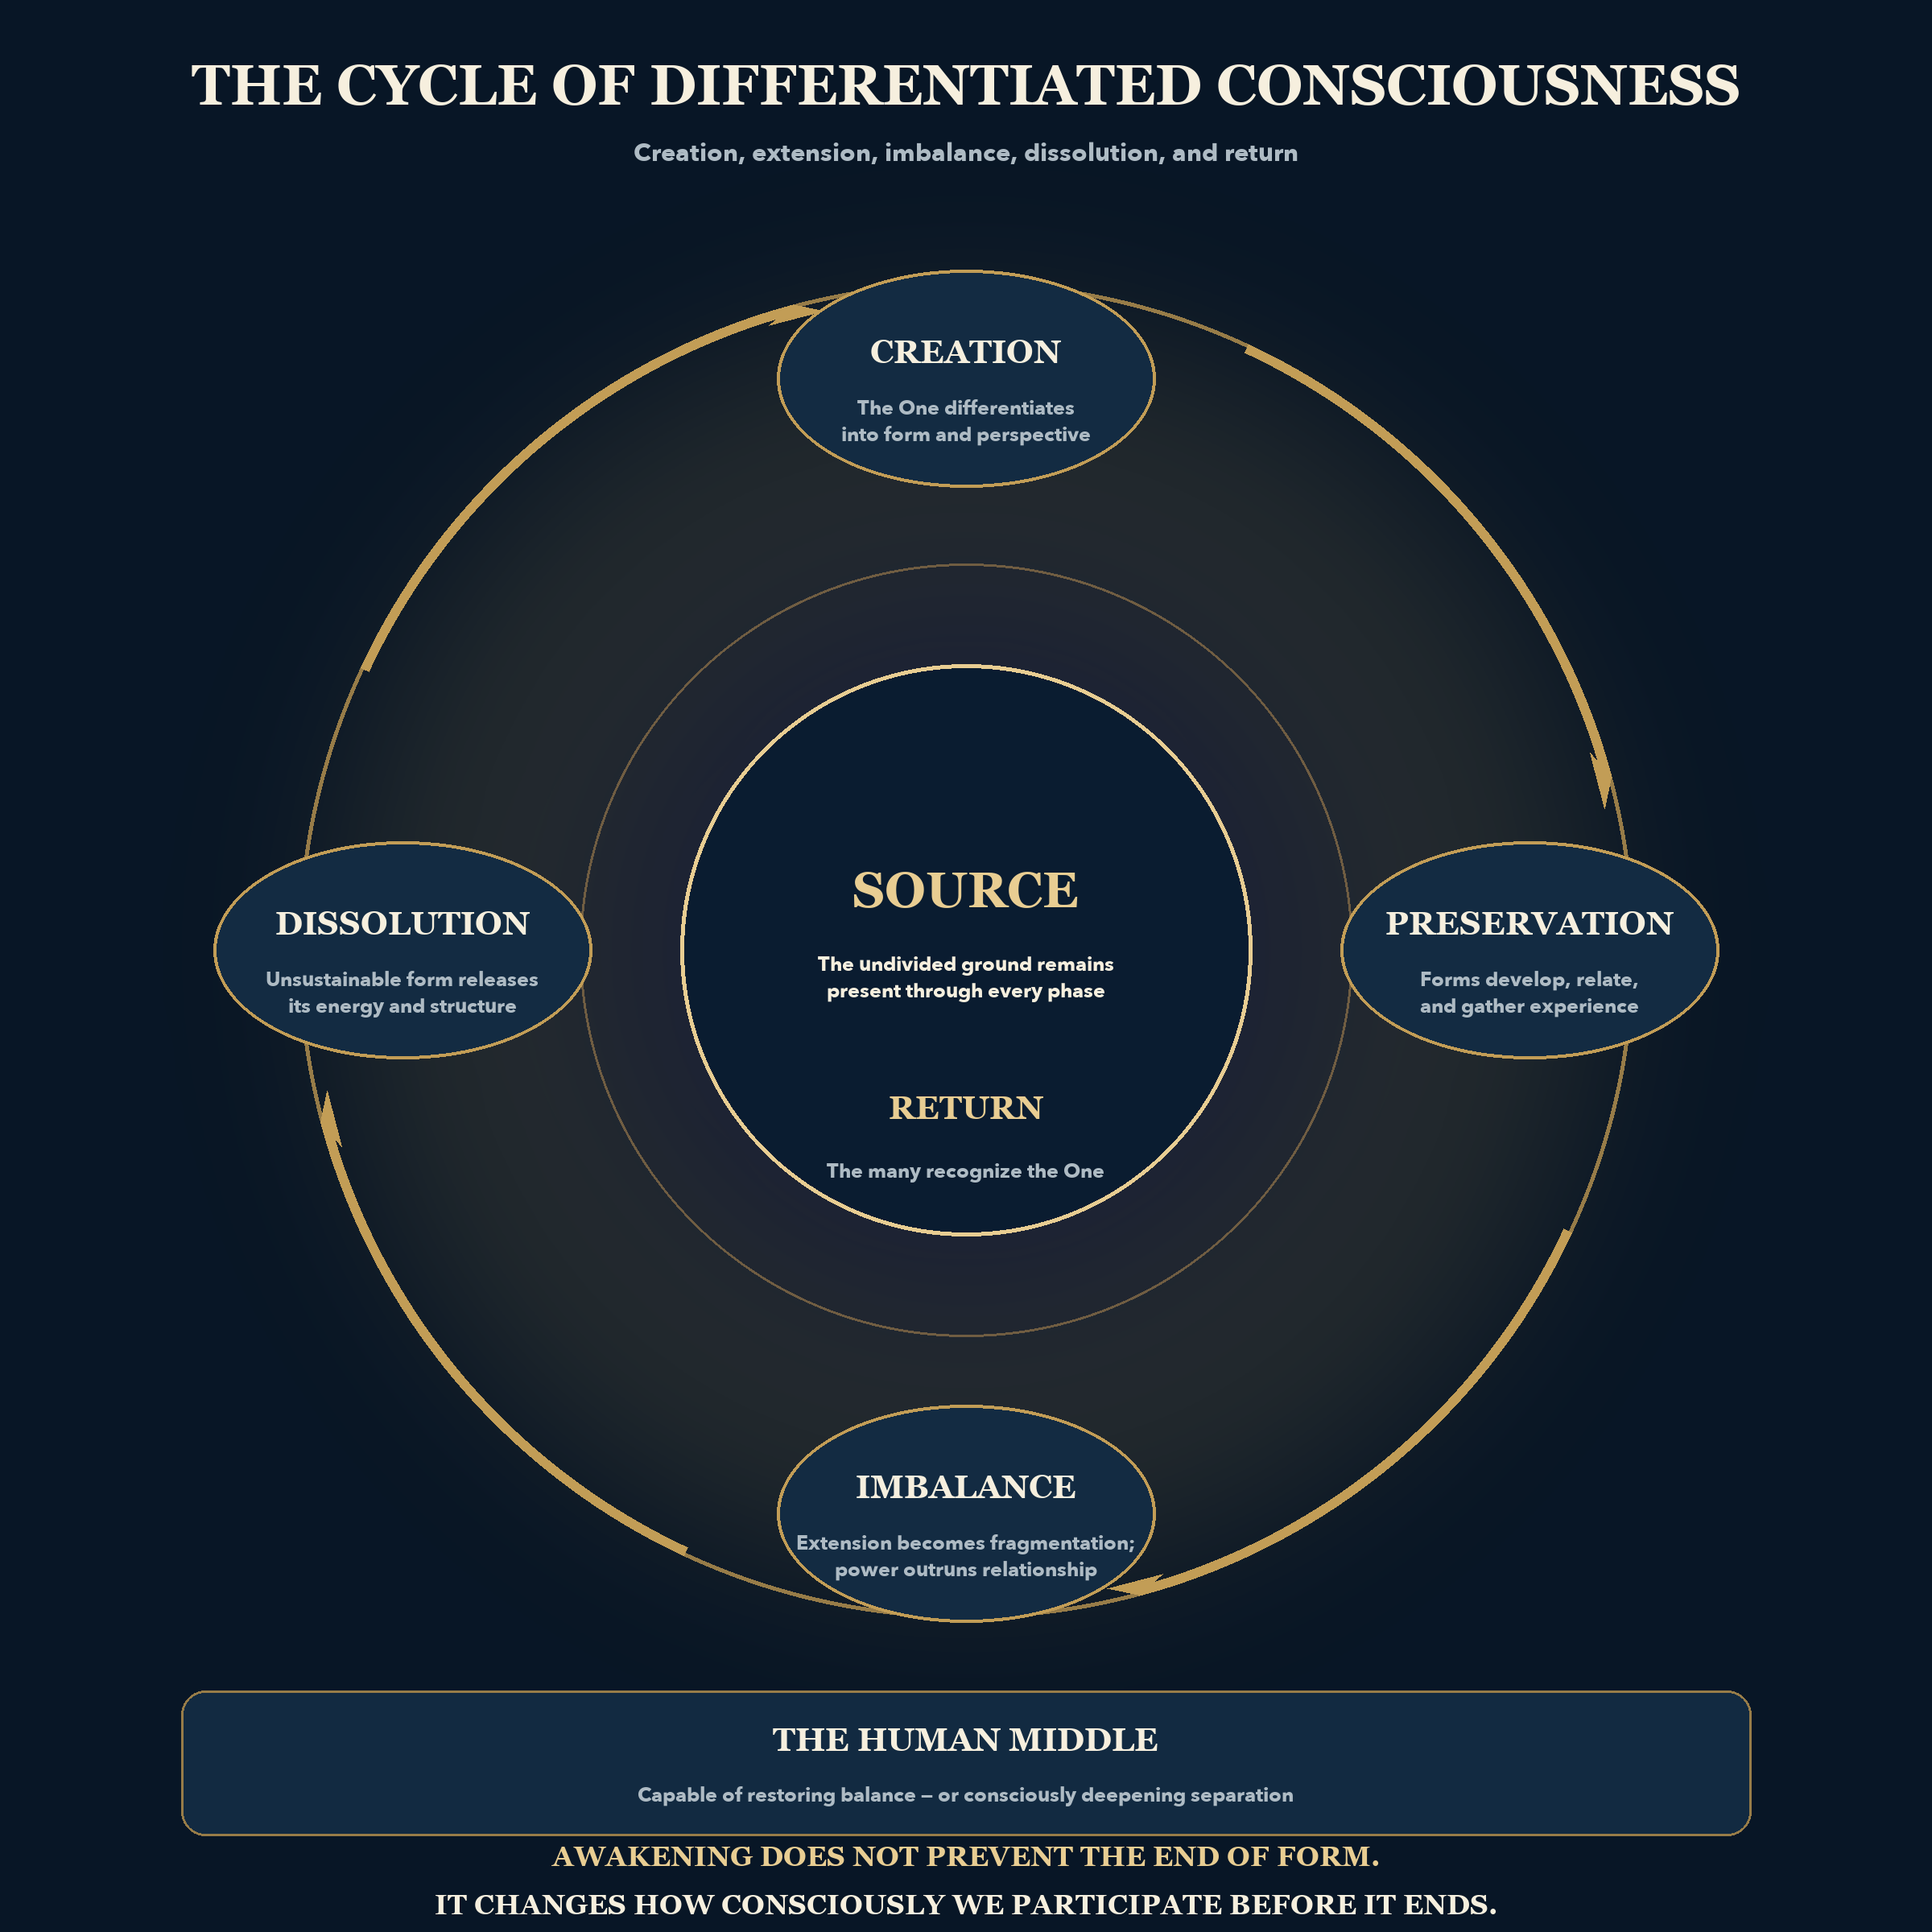
THE FRACTAL SELF
Cycle of Differentiated Consciousness
One appearing as many, and remembering itself as one.
The one field differentiates into many perspectives, each able to recognize the whole from inside a part.
REFLECTION
Where have you mistaken a part for the whole of yourself?
THE FRACTAL SELF
20

Slide 21

THE FRACTAL SELF
The Universe Awakens Through You
You are not separate from the universe you observe.
The human form is a local aperture through which the larger field can know a particular life from within.
REFLECTION
What changes when the body becomes an instrument rather than an identity?
THE FRACTAL SELF
21
Notes:
[Sources]
- The Central Thesis, paragraph 23; author-provided illustration
- Visual asset: existing/universe-awakening.png
- Written teaching: David Ramirez, The Central Thesis (updated Second Movement edition).

Slide 22
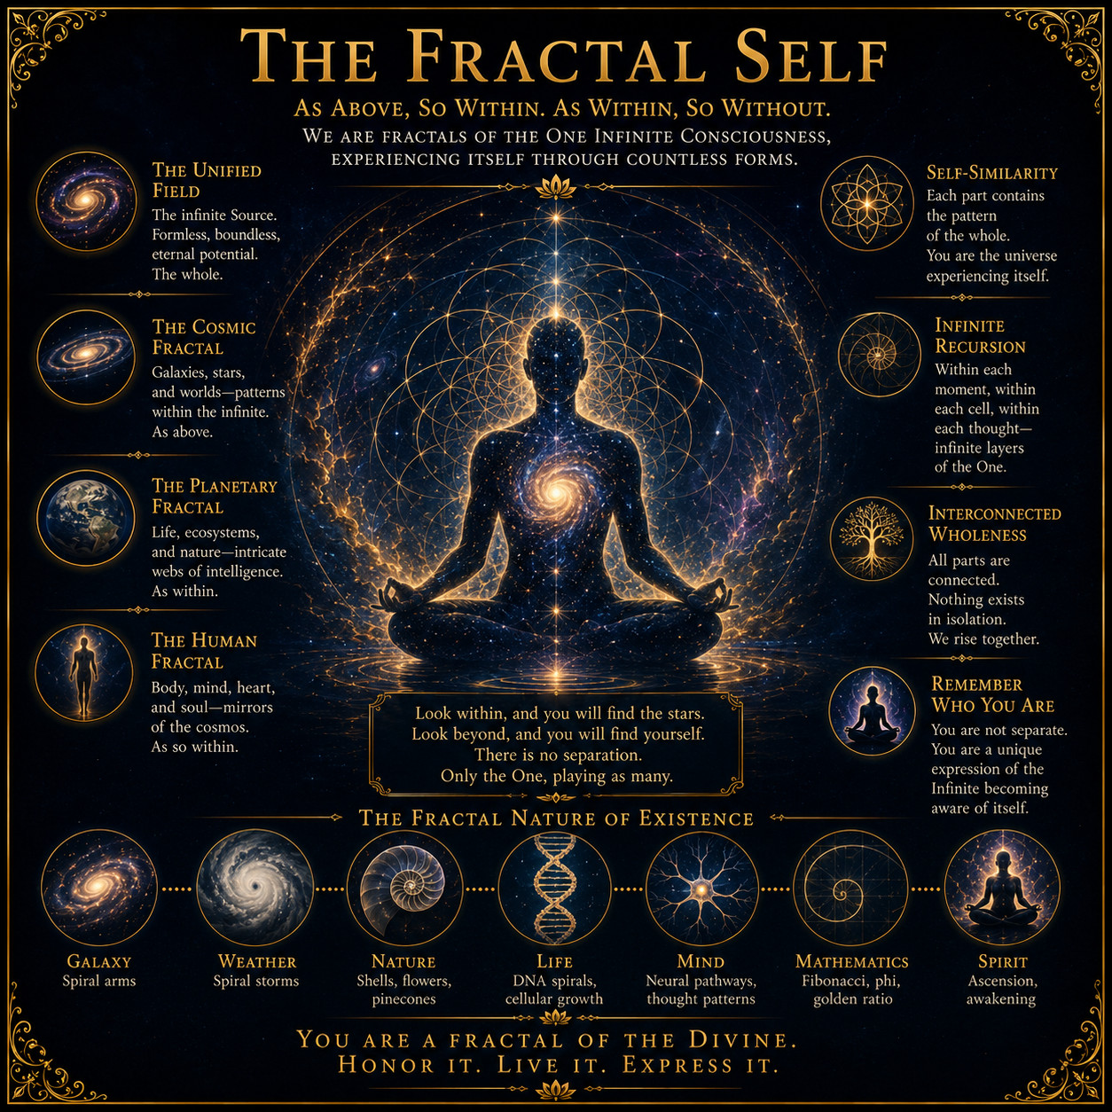
THE FRACTAL SELF
The Fractal Self
A larger pattern can repeat at a smaller, livable scale.
The dense body is the resolution at which a higher Self can touch this world. Form is not exile; it is participation.
REFLECTION
Where do you recognize the larger pattern within the smaller life?
THE FRACTAL SELF
22
Notes:
[Sources]
- The Central Thesis, paragraph 23; author-provided illustration
- Visual asset: existing/fractal-self.png
- Written teaching: David Ramirez, The Central Thesis (updated Second Movement edition).

Slide 23
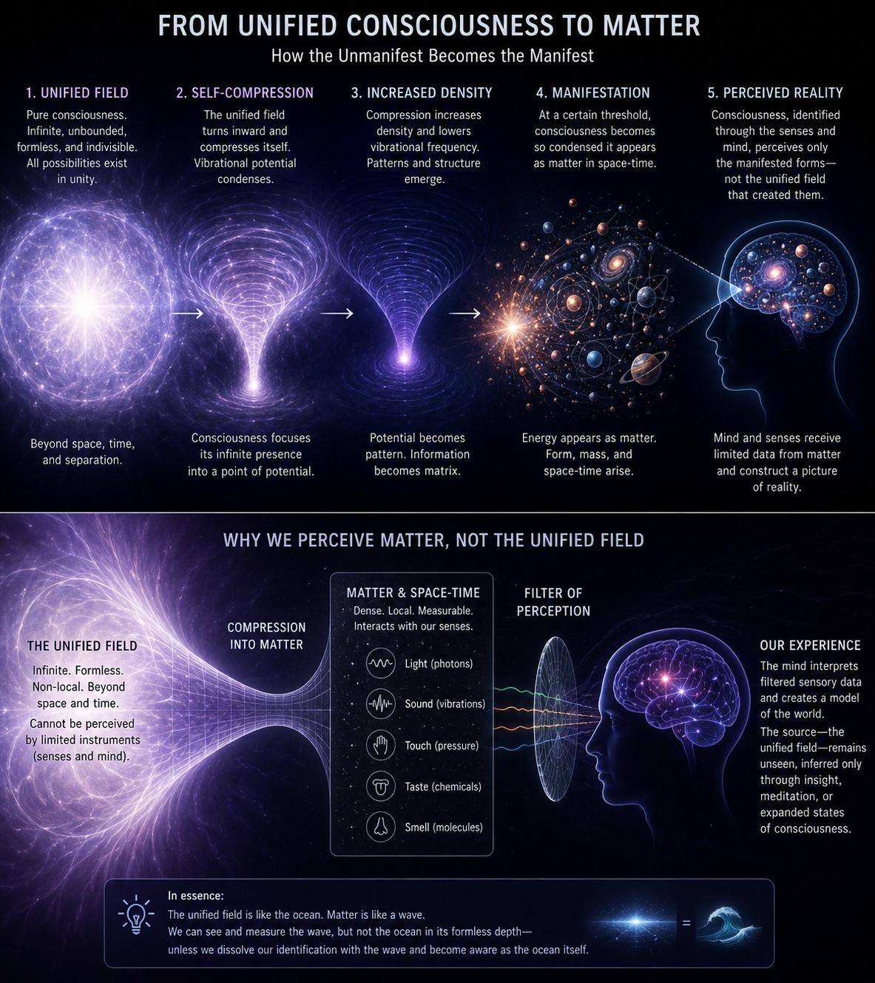
THE FRACTAL SELF
From Unified Consciousness
to Matter
The field becomes experience by narrowing into form.
Potential becomes vibration, geometry, energy, matter, biology and perception: the infinite translated into a scale the senses can meet.
REFLECTION
Where might perception be mistaking the translation for the source?
THE FRACTAL SELF
23
Notes:
[Sources]
- The Central Thesis; author-provided illustration
- Visual asset: existing/unified-consciousness-to-matter.png
- Written teaching: David Ramirez, The Central Thesis (updated Second Movement edition).

Slide 24
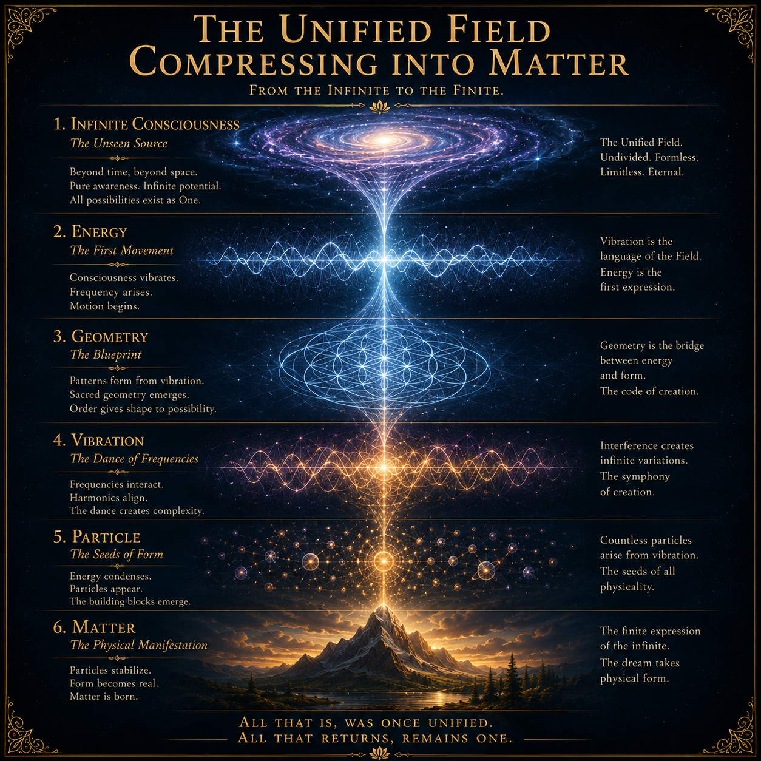
THE FRACTAL SELF
The Unified Field
Compressing into Matter
Form is concentrated possibility.
Matter is presented as a dense expression of the same field that appears inwardly as consciousness and awareness.
REFLECTION
What if density is not separation, but compression?
THE FRACTAL SELF
24
Notes:
[Sources]
- The Central Thesis; author-provided illustration
- Visual asset: existing/field-compressing.png
- Written teaching: David Ramirez, The Central Thesis (updated Second Movement edition).

Slide 25
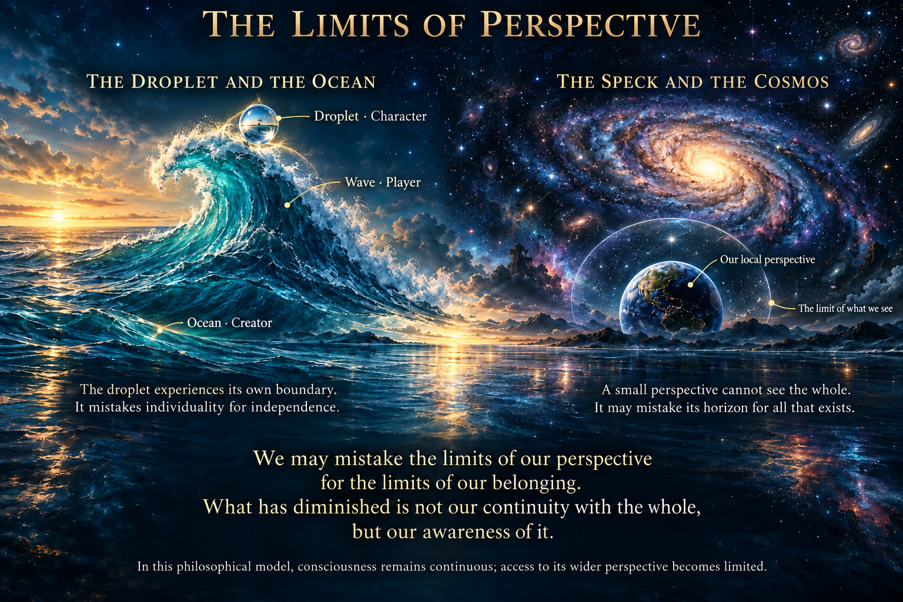
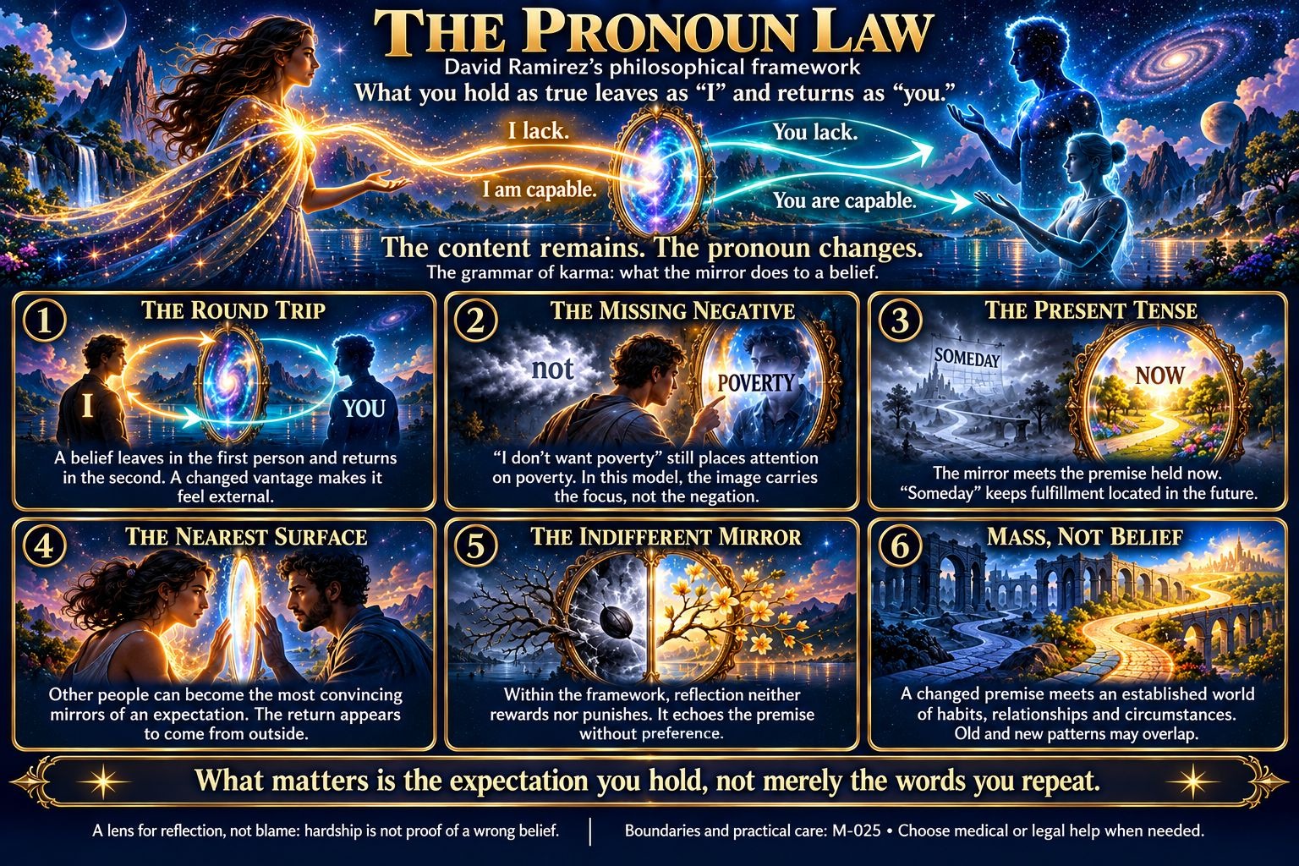
THE FRACTAL SELF
The Limits of Perspective
A boundary is a limit of vantage rather than a limit of belonging.
THE FRACTAL SELF
25

Slide 26
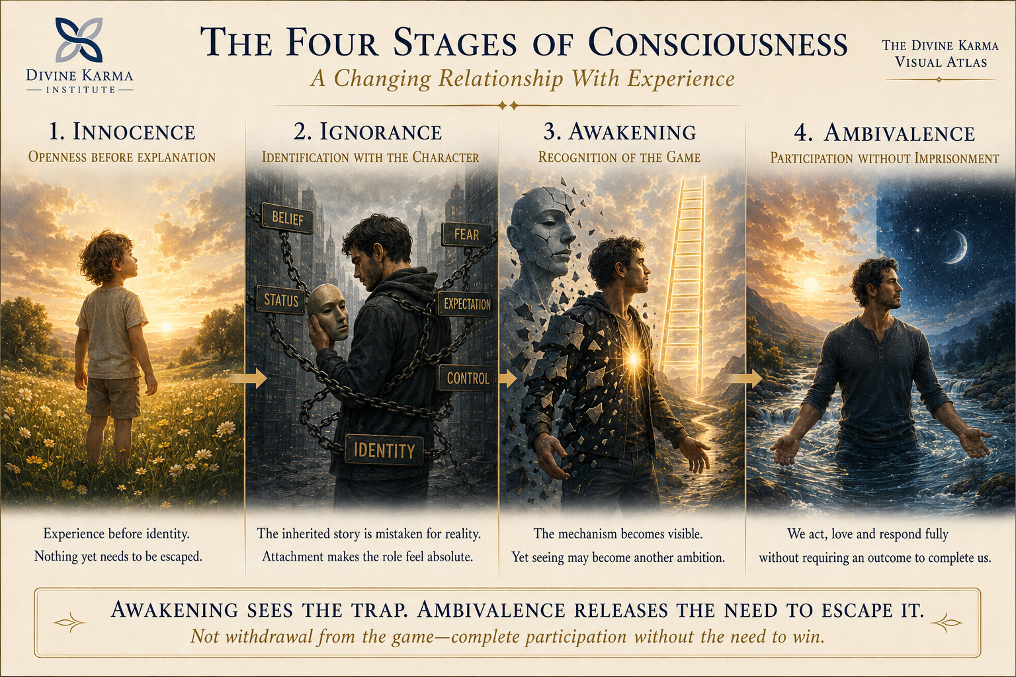
THE REVOLUTION OF THE MIND
The Four Stages of Consciousness
A changing relationship with experience.
THE REVOLUTION OF THE MIND
26
Notes:
[Sources]
- User-supplied corrected Divine Karma Visual Atlas illustration, August 18, 2026
- Visual asset: /Users/talos/Desktop/Divine Karma Institute/Codex Image Aug 18, 2026, 01_17_48 PM.png
- Written teaching: David Ramirez, The Central Thesis (updated Second Movement edition).

Slide 27
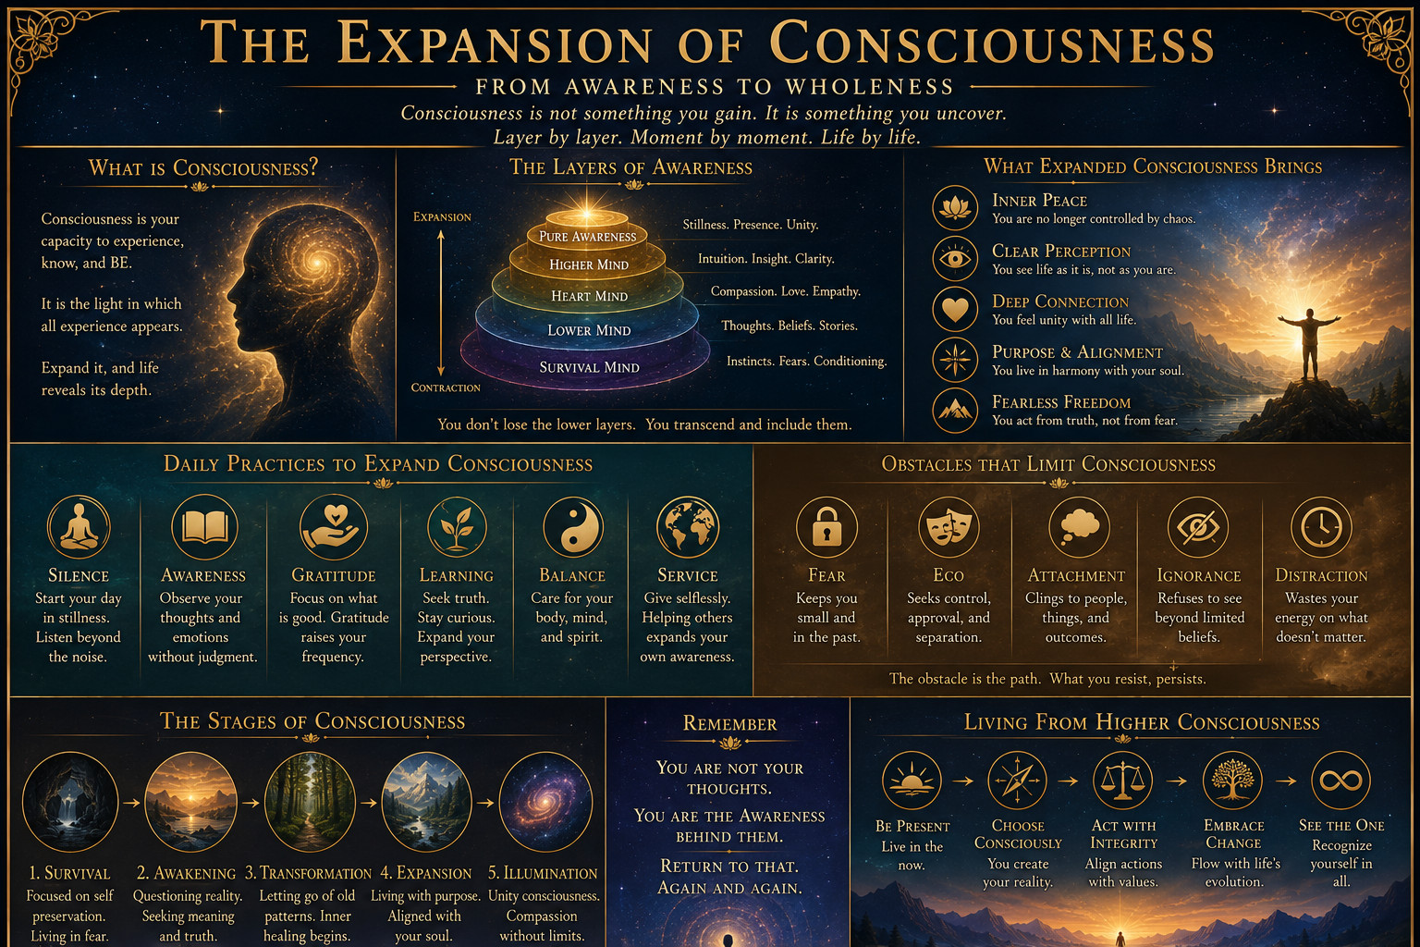
THE REVOLUTION OF THE MIND
The Expansion of Consciousness
Awareness widens when inherited boundaries are examined.
THE REVOLUTION OF THE MIND
27
Notes:
[Sources]
- The Central Thesis; The Revolution of the Mind; author-provided illustration
- Visual asset: existing/expansion-of-consciousness.png
- Written teaching: David Ramirez, The Central Thesis (updated Second Movement edition).

Slide 28
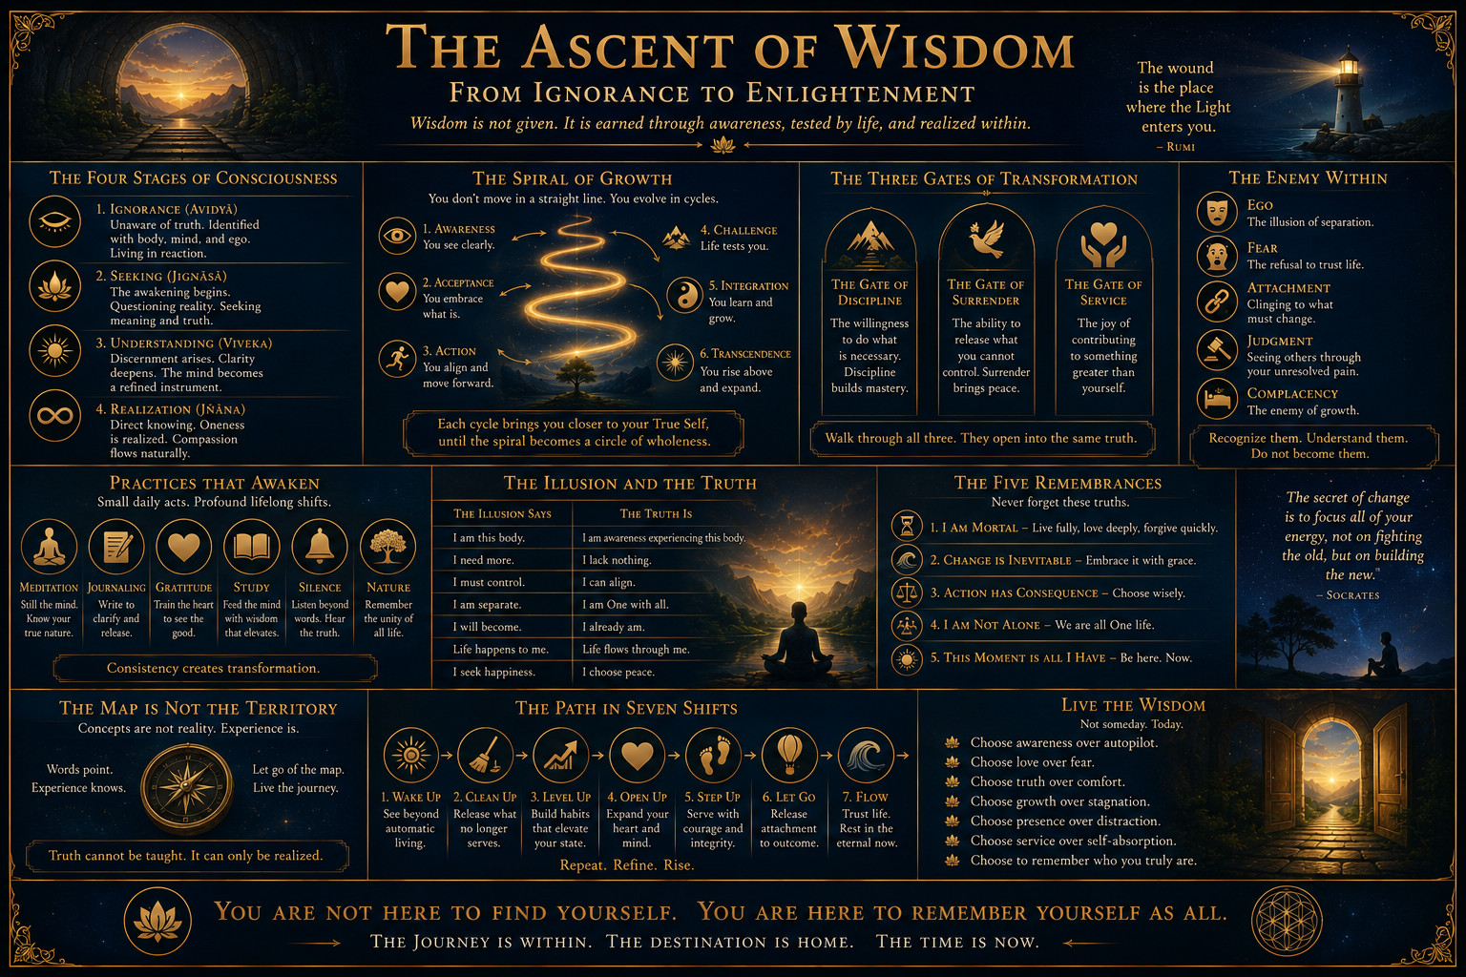
THE REVOLUTION OF THE MIND
The Ascent of Wisdom
Wisdom grows as reaction becomes observation.
THE REVOLUTION OF THE MIND
28
Notes:
[Sources]
- The Revolution of the Mind; author-provided illustration
- Visual asset: existing/ascent-of-wisdom.png
- Written teaching: David Ramirez, The Central Thesis (updated Second Movement edition).

Slide 29
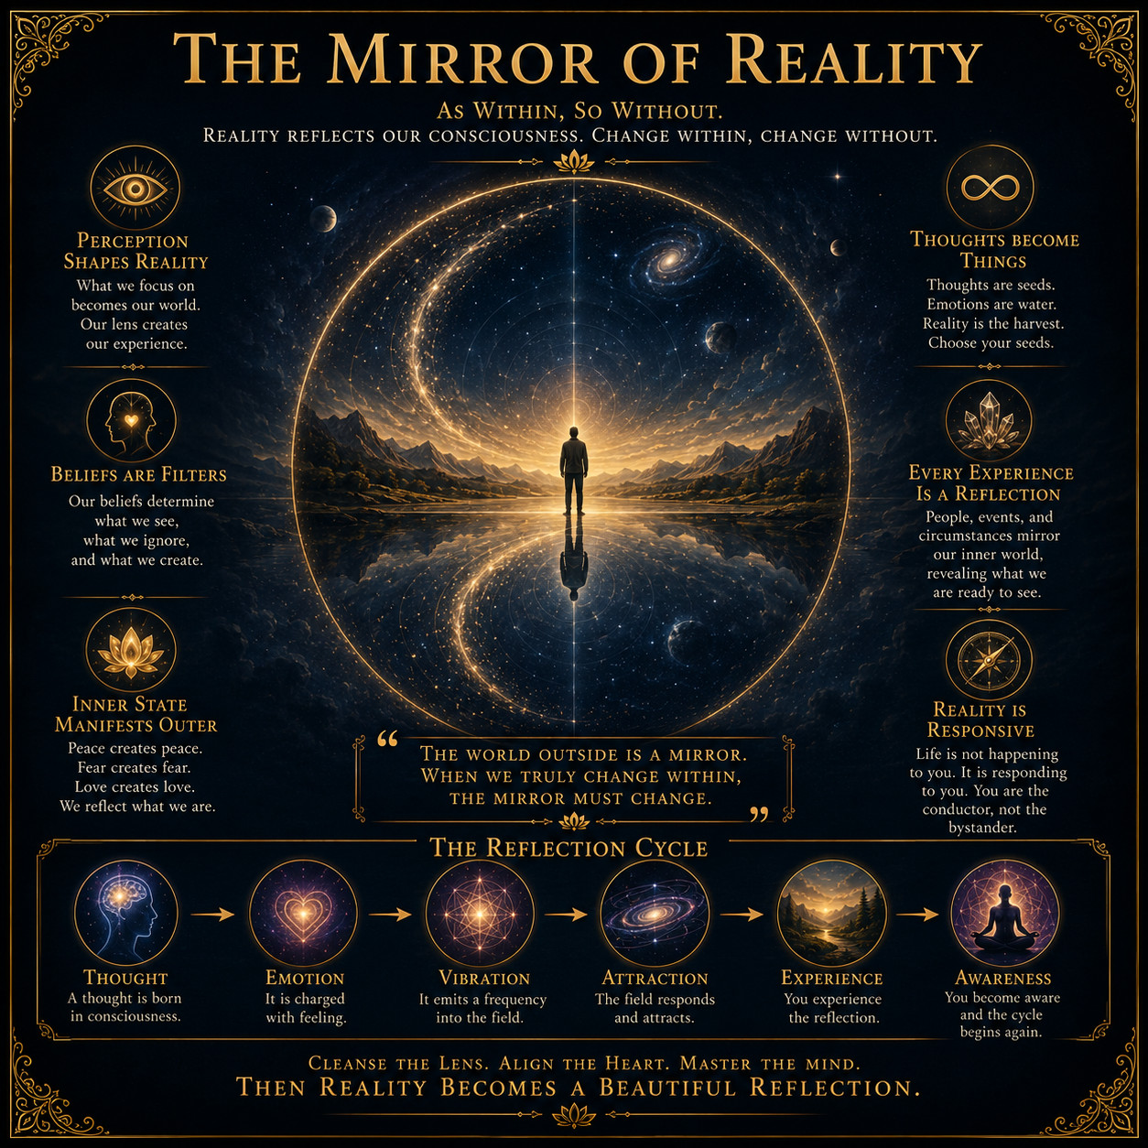
THE REVOLUTION OF THE MIND
The Mirror of Reality
We do not see reality as it is; we meet it through what we carry.
Belief filters perception. Perception shapes meaning. Meaning guides behavior, and behavior helps build the world that appears to confirm the belief.
REFLECTION
What is the current mirror teaching you about the lens?
THE REVOLUTION OF THE MIND
29
Notes:
[Sources]
- The Central Thesis, Resonance of Timelines; author-provided illustration
- Visual asset: existing/mirror-of-reality.png
- Written teaching: David Ramirez, The Central Thesis (updated Second Movement edition).

Slide 30
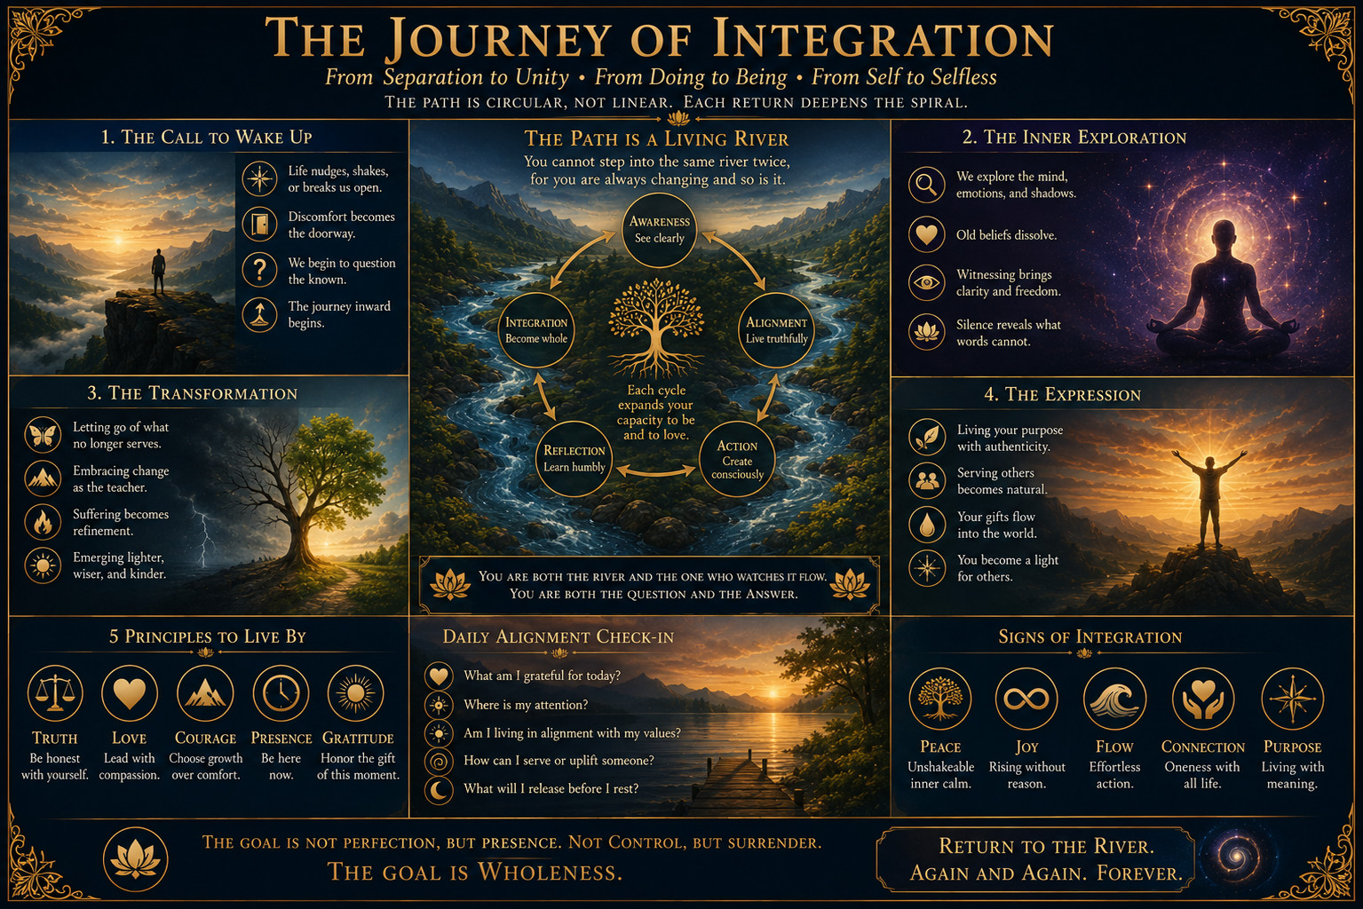
THE REVOLUTION OF THE MIND
The Journey of Integration
Awakening becomes stable through repeated integration.
THE REVOLUTION OF THE MIND
30
Notes:
[Sources]
- The Central Thesis; The Revolution of the Mind; author-provided illustration
- Visual asset: existing/journey-of-integration.png
- Written teaching: David Ramirez, The Central Thesis (updated Second Movement edition).

Slide 31
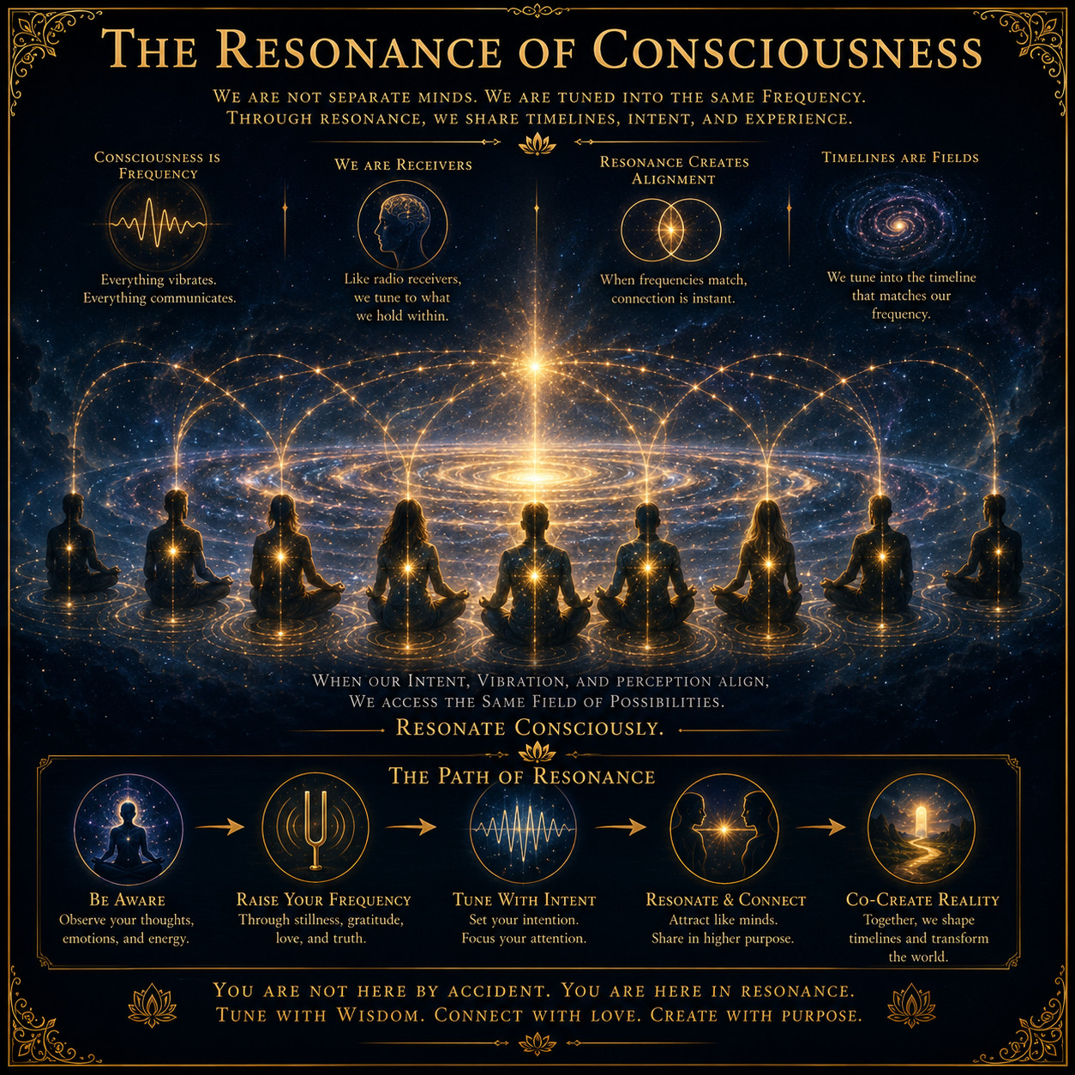
RESONANCE
The Resonance of Consciousness
Compatible frequencies can share one world without sharing one perspective.
Attention tunes perception like a receiver. When patterns resonate, separate people experience a common timeline from different seats.
REFLECTION
Which relationships are sustained by shared attention and belief?
RESONANCE
31
Notes:
[Sources]
- The Central Thesis, Resonance of Timelines; author-provided illustration
- Visual asset: existing/resonance-of-consciousness.png
- Written teaching: David Ramirez, The Central Thesis (updated Second Movement edition).

Slide 32
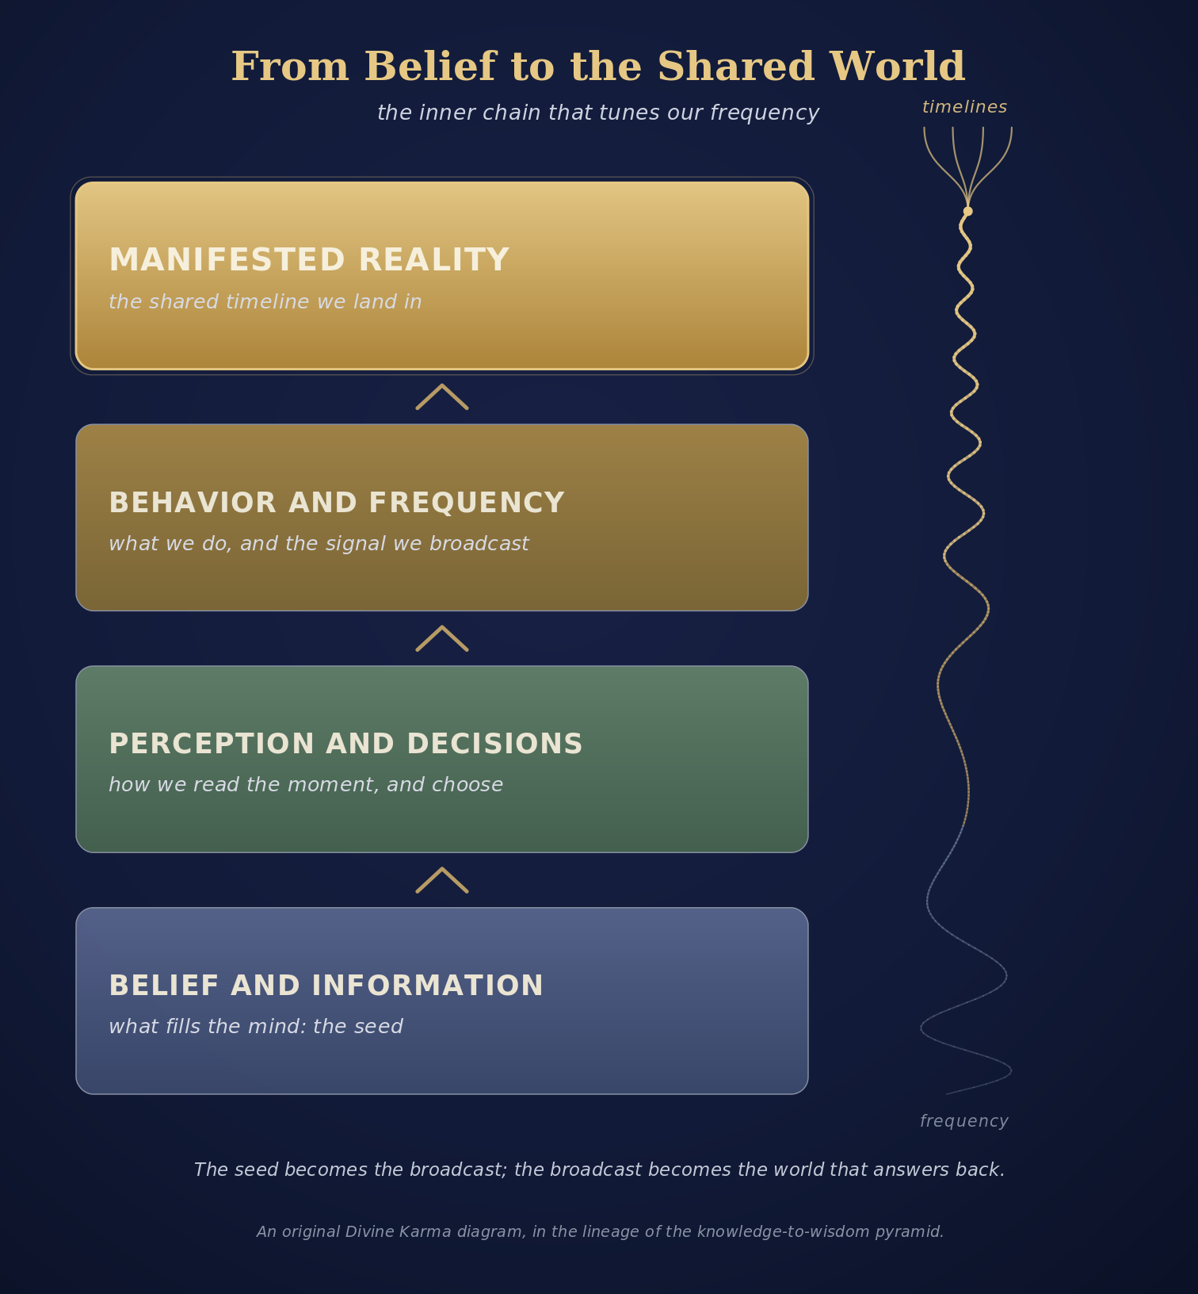
RESONANCE
From Belief to the Shared World
What fills the mind becomes the seed of the world we help create.
Belief shapes perception and decision; behavior carries the frequency outward; shared patterns become shared experience.
REFLECTION
What information are you repeatedly allowing to set your frequency?
RESONANCE
32
Notes:
[Sources]
- The Central Thesis, Resonance of Timelines; author-provided illustration
- Visual asset: existing/belief-to-shared-world.png
- Written teaching: David Ramirez, The Central Thesis (updated Second Movement edition).

Slide 33
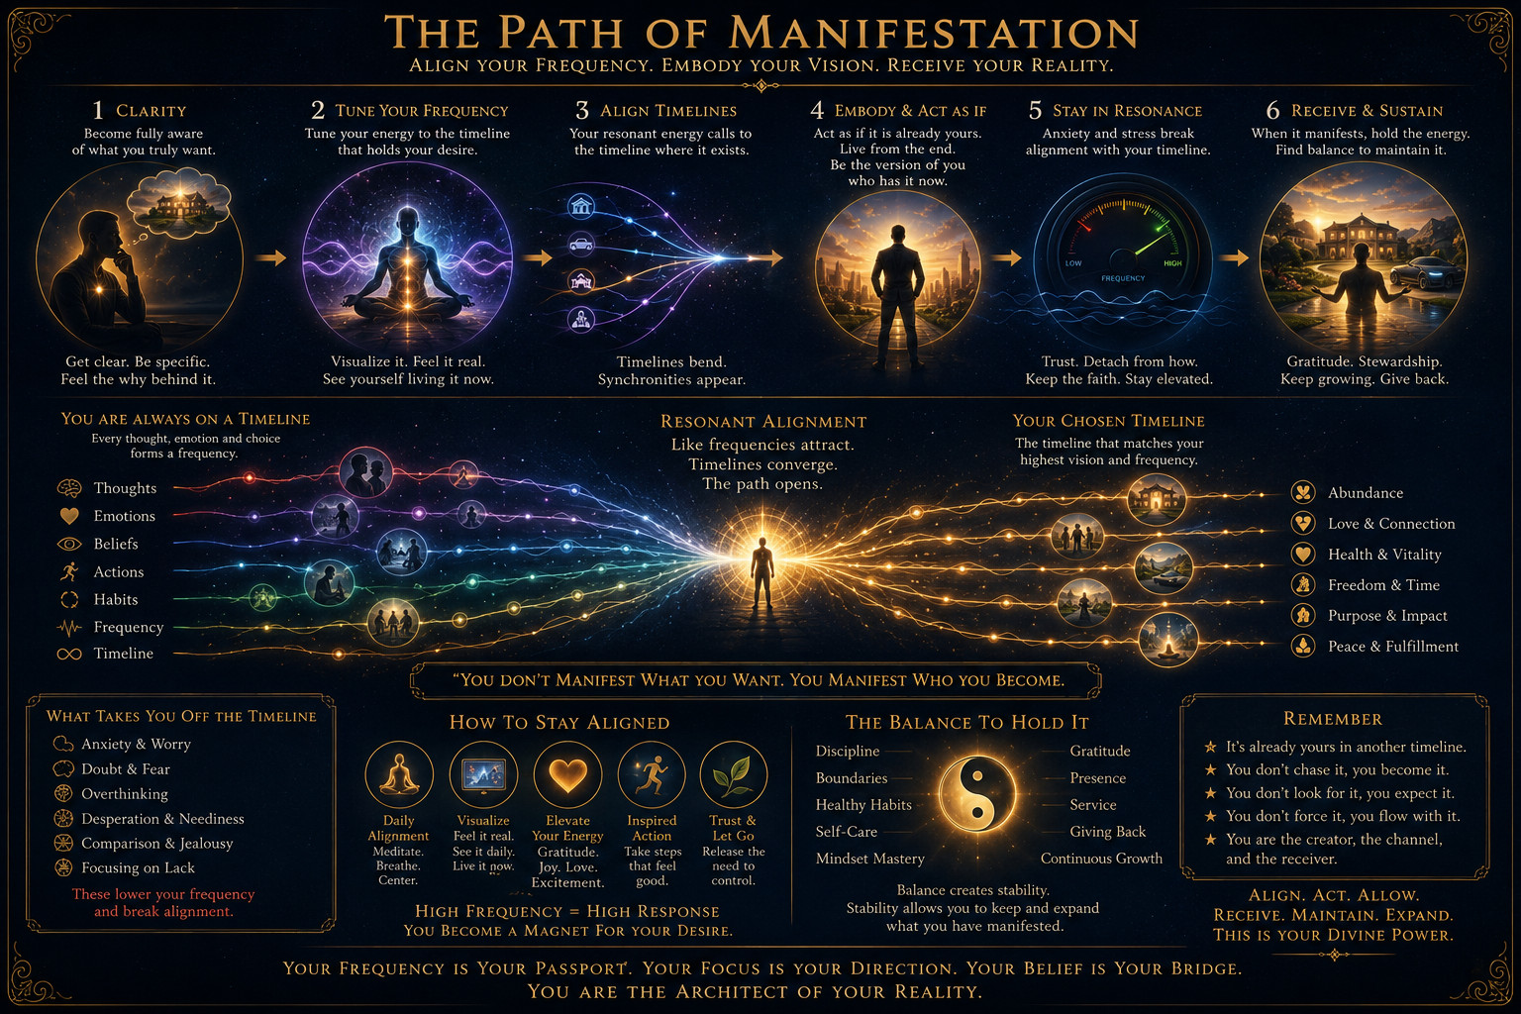
RESONANCE
The Path of Manifestation
Clarity, embodiment and balanced stewardship matter more than anxious pursuit.
RESONANCE
33
Notes:
[Sources]
- The Central Thesis; author-provided illustration
- Visual asset: existing/path-of-manifestation.png
- Written teaching: David Ramirez, The Central Thesis (updated Second Movement edition).

Slide 34
RESONANCE
The Pronoun Law
What you hold as true leaves you in the first person and returns to you in the second.
RESONANCE
34

Slide 35
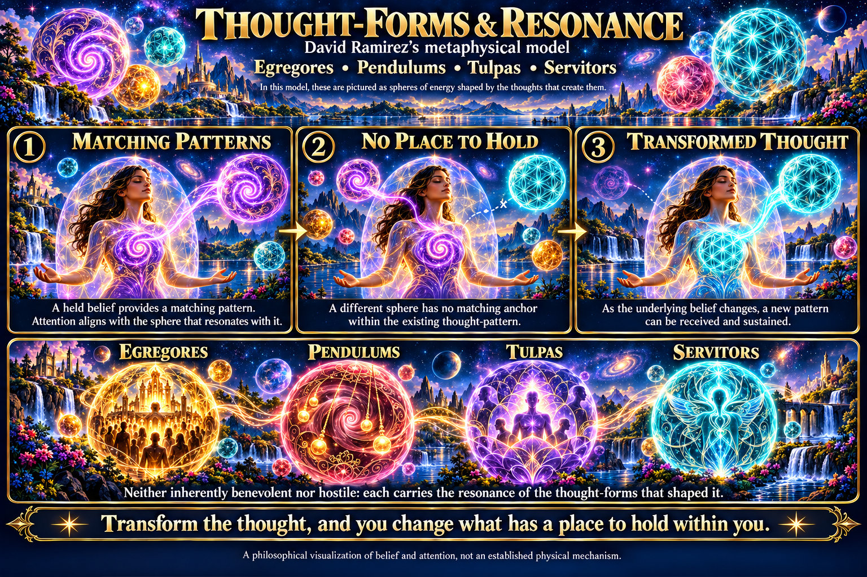
RESONANCE
Thought Forms and Resonance
A form takes hold where something already held gives it an anchor.
RESONANCE
35

Slide 36
KAIROS
The Daily Alignment
A simple daily check-in: are we aligned, or drifting?
KAIROS
36

Slide 37
KAIROS
The Balanced Daily Ritual
The small acts that keep a day in balance.
KAIROS
37

Slide 38
KAIROS
Awareness Returns
Consciousness evolves, awareness returns, being remains.
KAIROS
38

Slide 39
KAIROS
Living From Awareness
Widening awareness, one ordinary day at a time.
KAIROS
39

Slide 40
SANKALPA
The Descent Into Form
The infinite condensing into matter, the same path our intentions travel.
An intention follows the same narrowing the field itself follows: possibility, attention, action, form.
REFLECTION
At which step does your intention usually stop?
SANKALPA
40

Slide 41
SANKALPA
Virtue Into Action
Balance turned into how we actually act.
The mean is not a compromise. It is the point at which a quality becomes usable.
REFLECTION
Which virtue of yours has tipped into excess?
SANKALPA
41

Slide 42
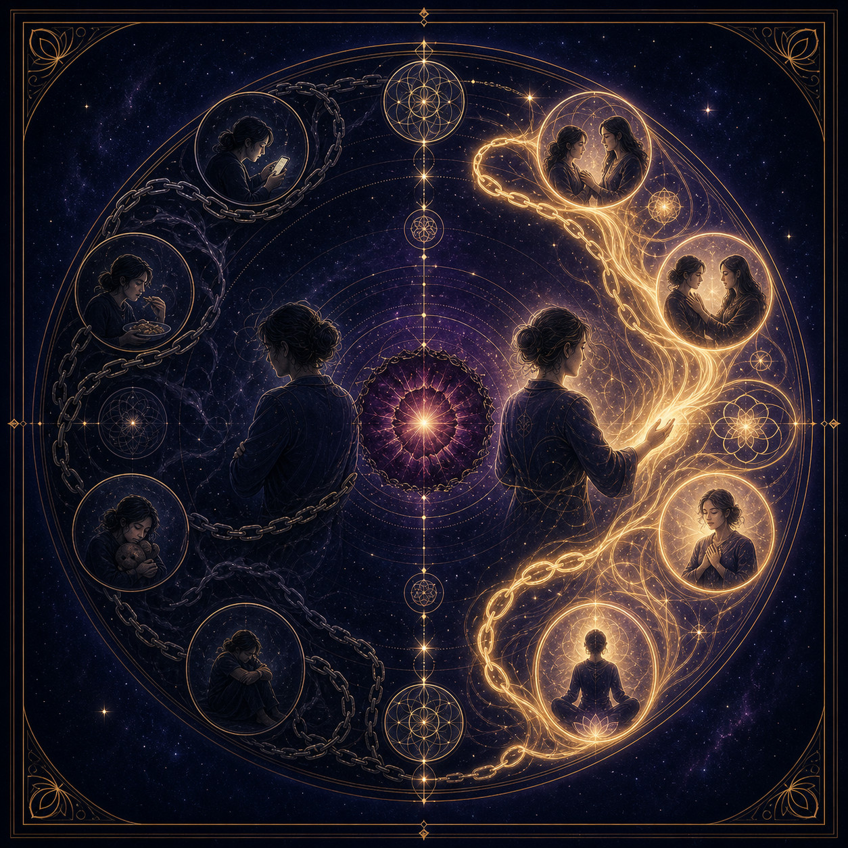
HEALING
From Avoidance to Healing
A pattern changes when the one carrying it turns toward its cause.
Distraction offers temporary numbness. Awareness allows the unresolved wound to be faced, understood and transformed into a new way of living.
REFLECTION
What does your most familiar escape protect you from feeling?
HEALING
42

Slide 43
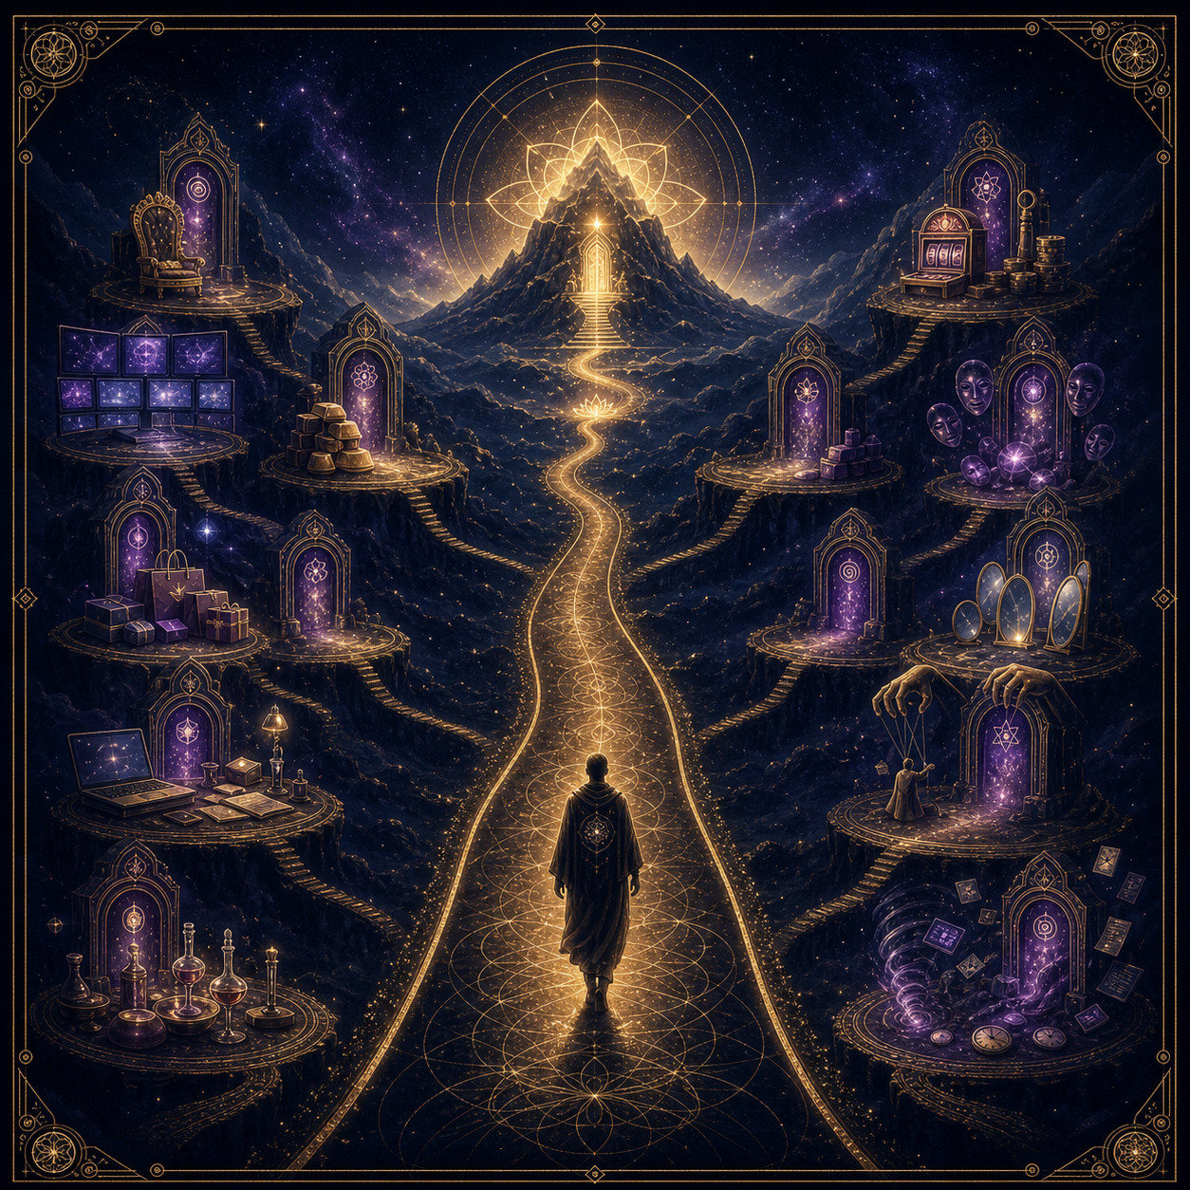
THE SECOND MOVEMENT
Traps and Distractions
The object differs; the movement away is the same.
Status, screens, work, consumption, control and spiritual performance can all turn attention away from what is asking to be healed.
REFLECTION
What do you reach for when stillness begins to feel uncomfortable?
THE SECOND MOVEMENT
43
Notes:
[Sources]
- The Central Thesis, paragraphs 15, 30 to 31; OpenAI ImageGen illustration
- Visual asset: second-movement/traps-and-distractions.png
- Written teaching: David Ramirez, The Central Thesis (updated Second Movement edition).

Slide 44
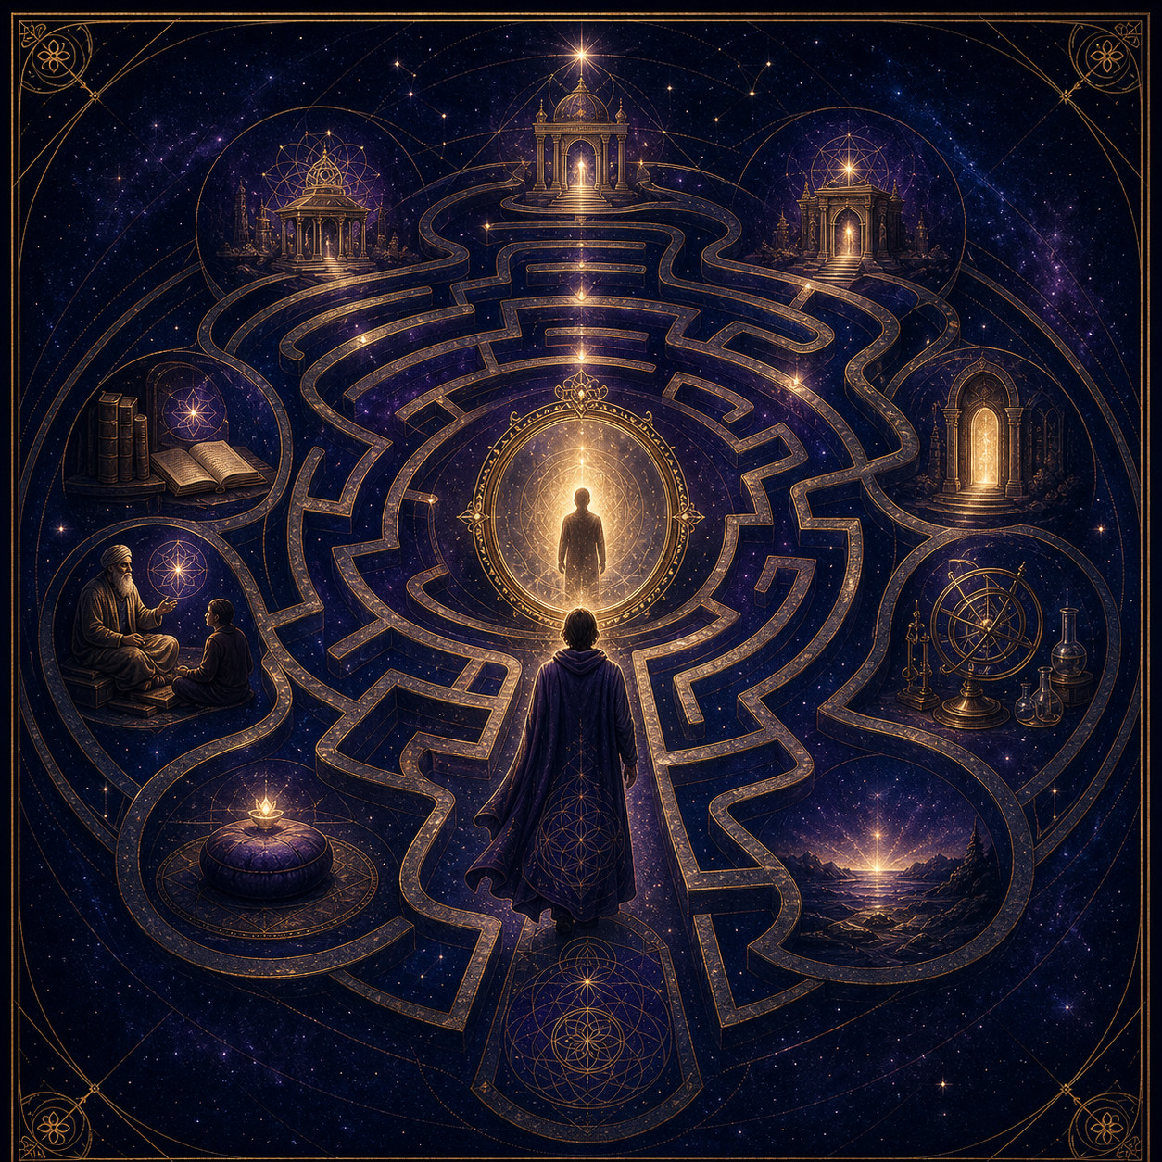
THE SECOND MOVEMENT
The Illusion of Seeking
The seeker was always standing where the search hoped to arrive.
Teachings can reveal the path, but endless pursuit keeps wholeness one more teacher, book, initiation or lifetime away.
REFLECTION
Is your current search revealing something, or postponing arrival?
THE SECOND MOVEMENT
44
Notes:
[Sources]
- The Central Thesis, The Illusion of Seeking; OpenAI ImageGen illustration
- Visual asset: second-movement/illusion-of-seeking.png
- Written teaching: David Ramirez, The Central Thesis (updated Second Movement edition).

Slide 45
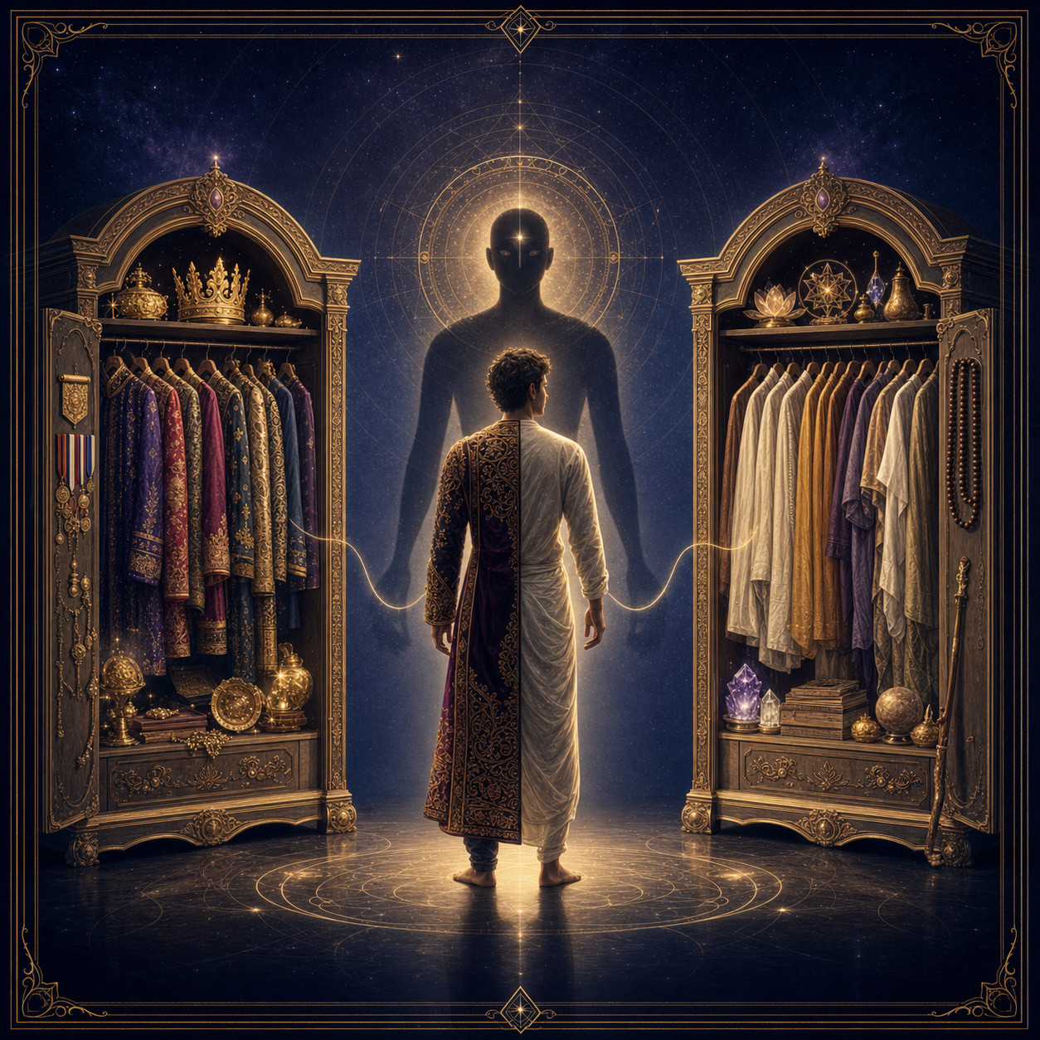
THE SECOND MOVEMENT
The Spiritual Costume
The costume changes. The wearer does not.
When worldly identity loosens, the ego can reorganize around mystical experience, secret knowledge or power over reality.
REFLECTION
Where has self-improvement quietly become self-definition?
THE SECOND MOVEMENT
45
Notes:
[Sources]
- The Central Thesis, The Illusion of Seeking, paragraph 36; OpenAI ImageGen illustration
- Visual asset: second-movement/spiritual-costume.png
- Written teaching: David Ramirez, The Central Thesis (updated Second Movement edition).

Slide 46
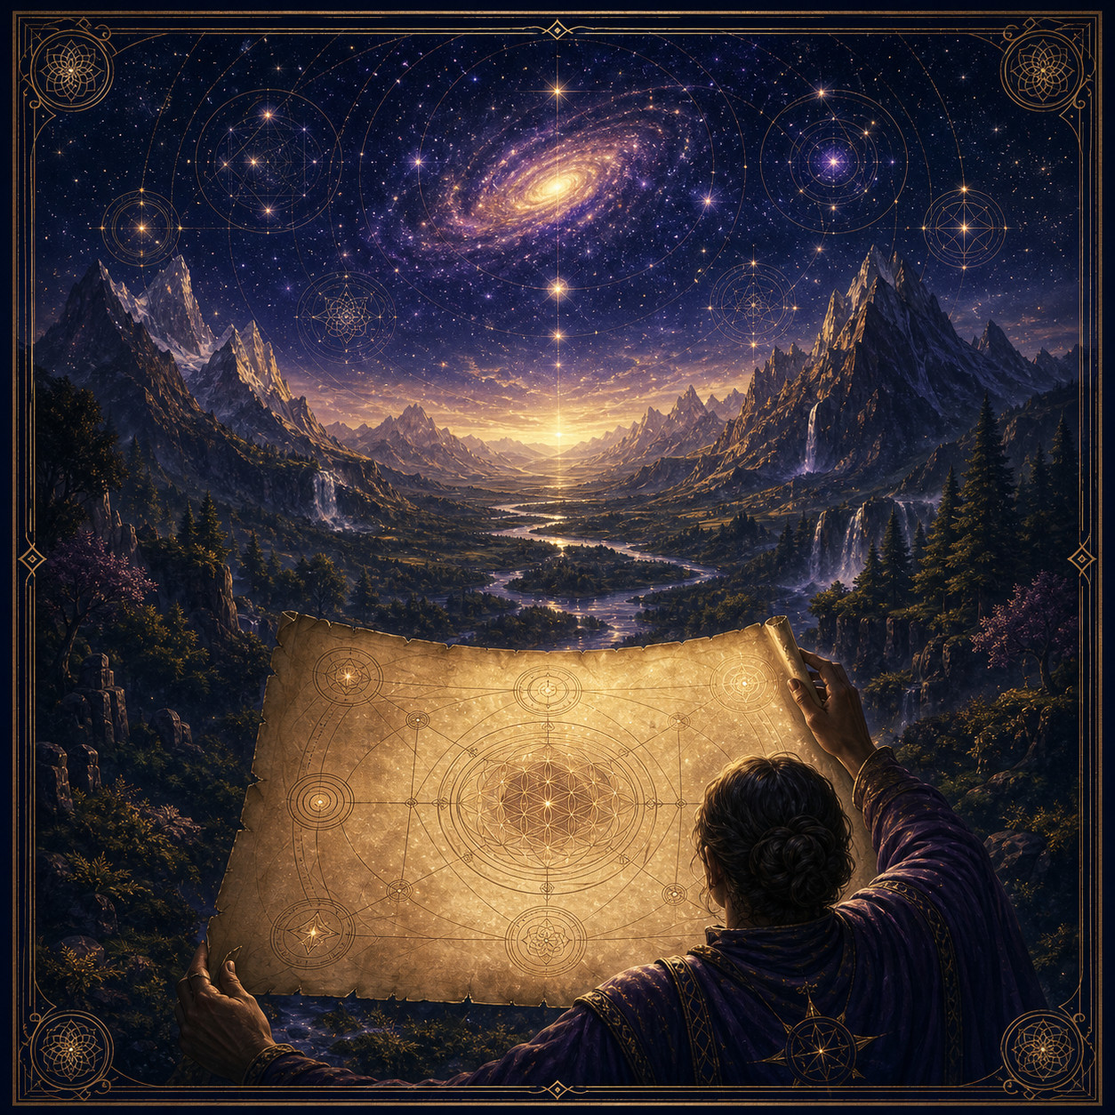
THE SECOND MOVEMENT
The Map and the Territory
A map is invaluable until it is mistaken for reality.
Every teaching carries fragments of truth. It becomes limiting when explanation replaces direct experience and identity begins defending the map.
REFLECTION
Which explanation have you begun protecting as if it were the whole?
THE SECOND MOVEMENT
46
Notes:
[Sources]
- The Central Thesis, The Illusion of Seeking, paragraph 37; OpenAI ImageGen illustration
- Visual asset: second-movement/map-and-territory.png
- Written teaching: David Ramirez, The Central Thesis (updated Second Movement edition).

Slide 47
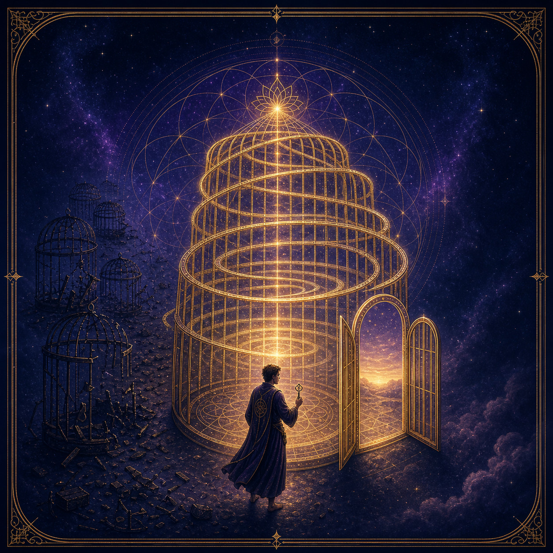
THE SECOND MOVEMENT
The Cage Called Seeking
The search for freedom can become the final room of the prison.
The mind builds destination after destination because its identity depends on movement. The open door can remain unseen while another key is pursued.
REFLECTION
What would remain if there were nowhere else to arrive?
THE SECOND MOVEMENT
47
Notes:
[Sources]
- The Central Thesis, The Illusion of Seeking, paragraph 38; OpenAI ImageGen illustration
- Visual asset: second-movement/cage-called-seeking.png
- Written teaching: David Ramirez, The Central Thesis (updated Second Movement edition).

Slide 48
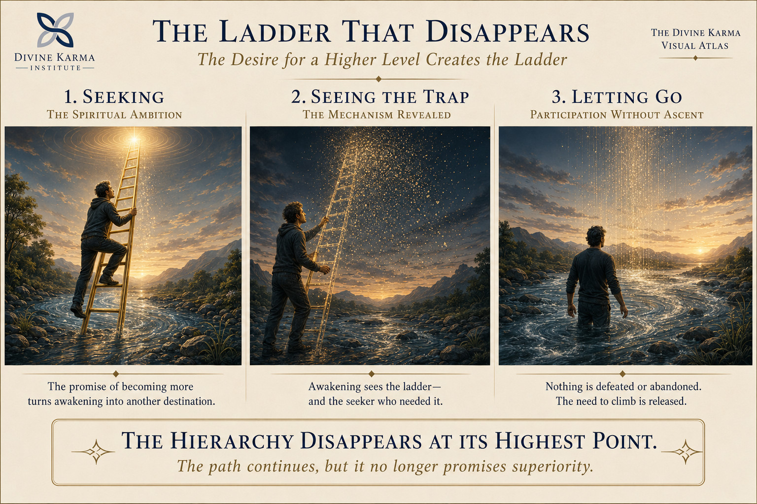
THE SECOND MOVEMENT
The Ladder That Disappears
The desire for a higher level creates the ladder.
THE SECOND MOVEMENT
48
Notes:
[Sources]
- User-supplied Divine Karma Visual Atlas illustration, August 18, 2026
- Visual asset: /Users/talos/Desktop/Divine Karma Institute/Codex Image Aug 18, 2026, 01_17_31 PM.png
- Written teaching: David Ramirez, The Central Thesis (updated Second Movement edition).

Slide 49

BEYOND AWAKENING
The Four Stages, Refreshed
A changing relationship with experience.
BEYOND AWAKENING
49

Slide 50
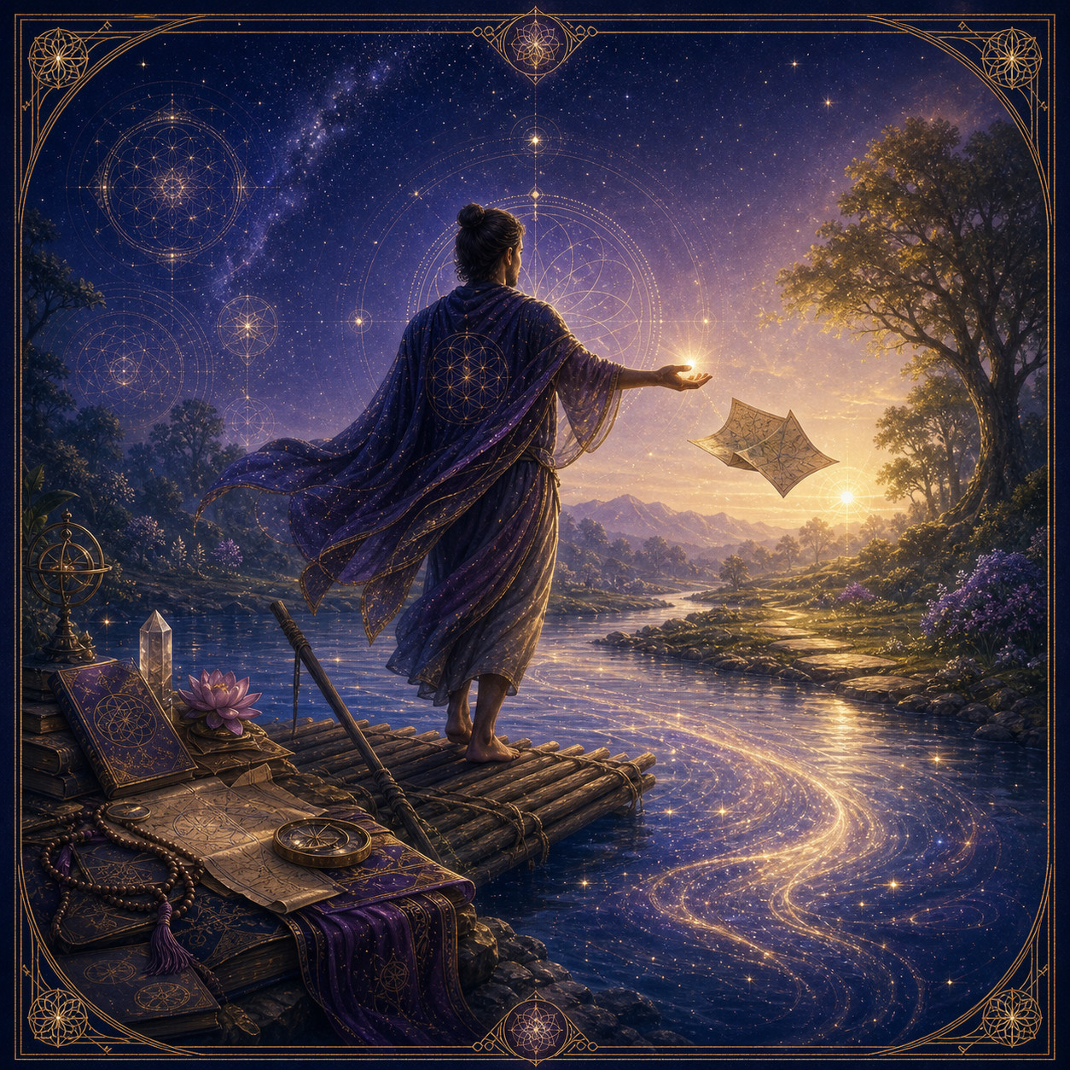
THE SECOND MOVEMENT
The Open Hand
Use the raft. Cross. Then set it down.
Every philosophy, including this one, is provisional. Nothing is rejected, but no explanation replaces the direct experience of being.
REFLECTION
Which useful tool are you now ready to stop carrying?
THE SECOND MOVEMENT
50
Notes:
[Sources]
- The Central Thesis, The Illusion of Seeking, paragraph 40; OpenAI ImageGen illustration
- Visual asset: second-movement/open-hand.png
- Written teaching: David Ramirez, The Central Thesis (updated Second Movement edition).

Slide 51
THE OPEN HAND
Nothing essential
was ever missing.
Use the raft. Cross. Set it down.
SO WE LET GO.
THE DIVINE KARMA ATLAS
51
Notes:
[Sources]
- The Central Thesis, second movement and four-word distilled form
- Visual asset: No external visual asset
- Written teaching: David Ramirez, The Central Thesis (updated Second Movement edition).

